Slide 1

Weekly composting procedure
Solving Organic Waste
DD Month 2025

Slide 2
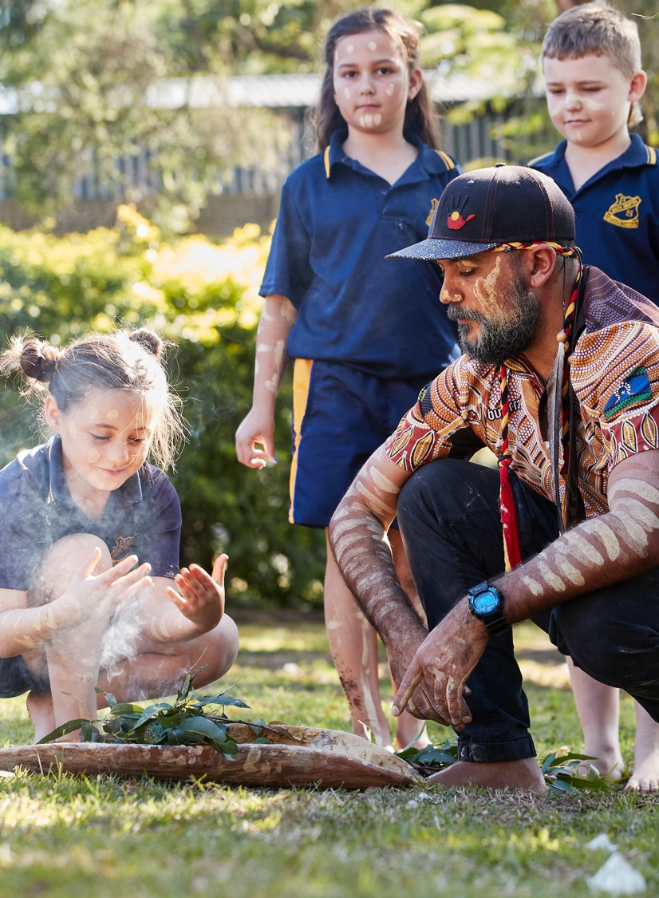
Acknowledgement of Country
We recognise the Ongoing Custodians of the lands and waterways where we work and live. We pay respect to Elders past and present as ongoing teachers of knowledge, songlines and stories.
We strive to ensure every Aboriginal and Torres Strait Islander learner in NSW achieves their potential through education.

Slide 3
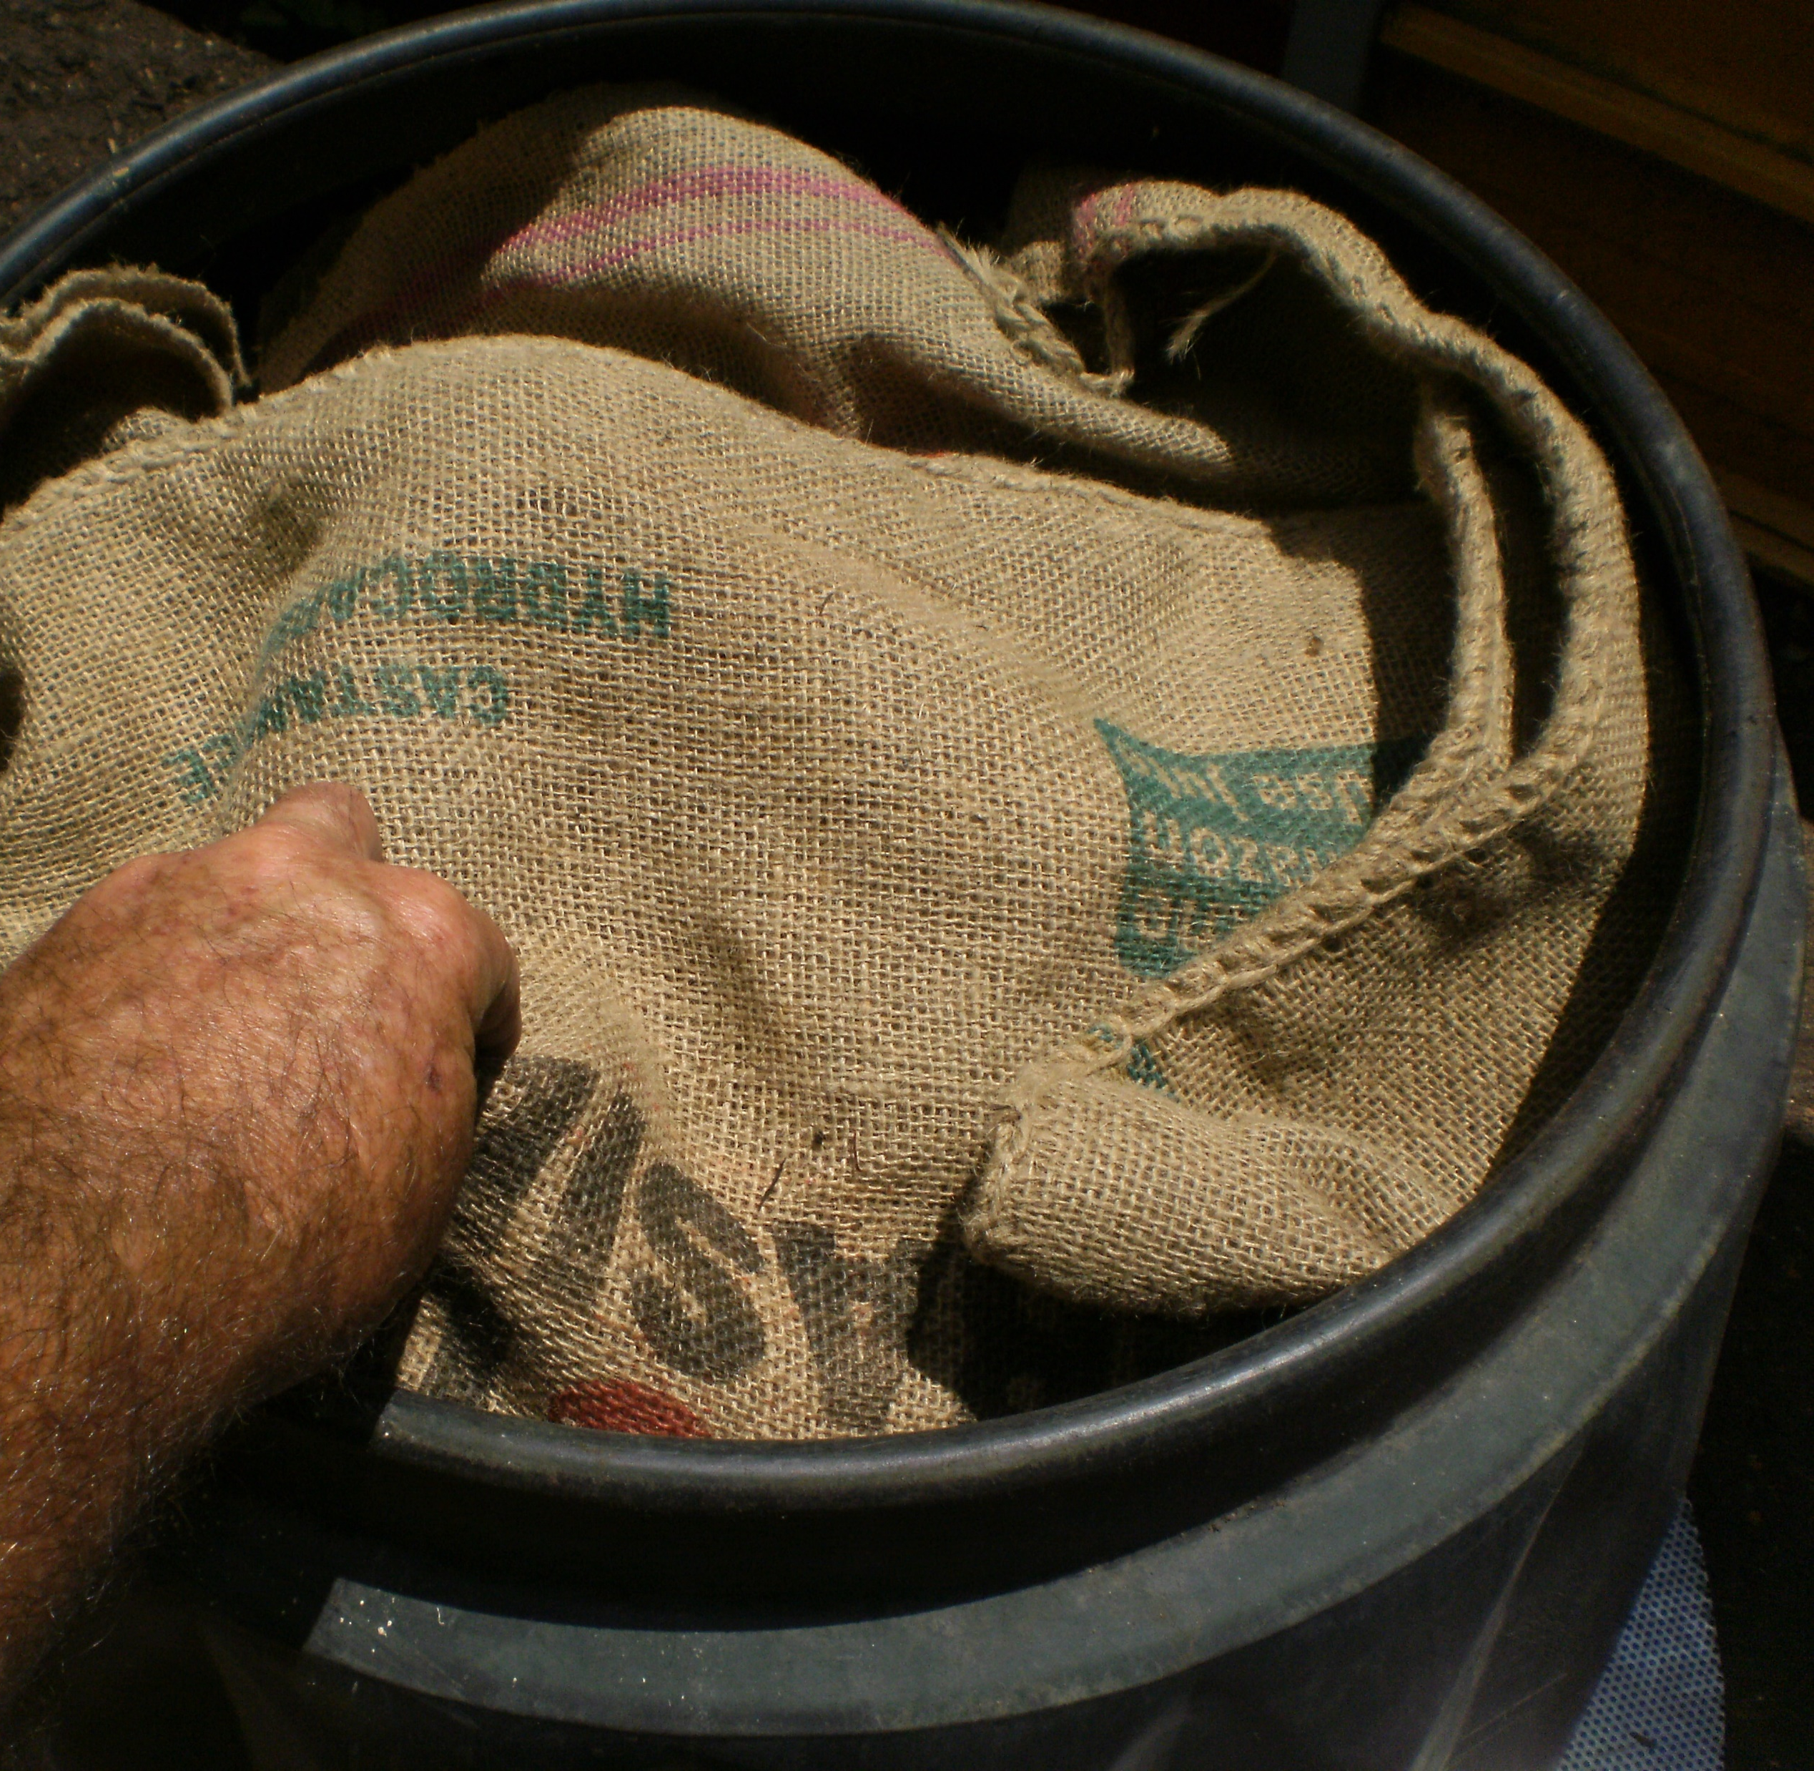
1. Take off the lid and blanket

Slide 4
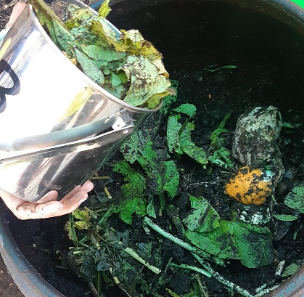
2. Tip in the food scraps

Slide 5
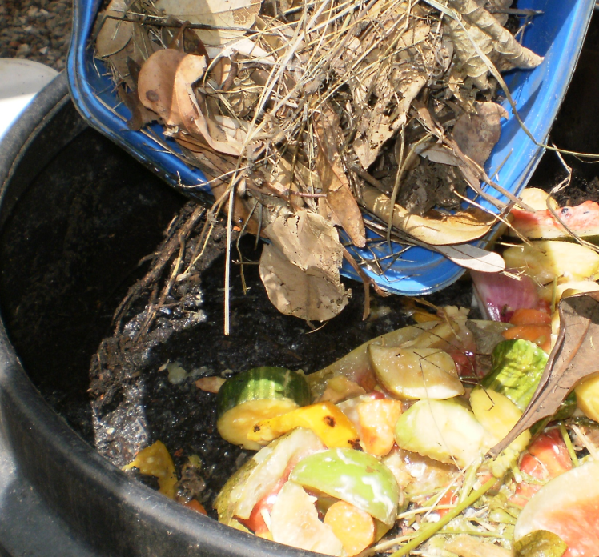
3. Tip in the same volume of leaves or fine woody mulch

Slide 6
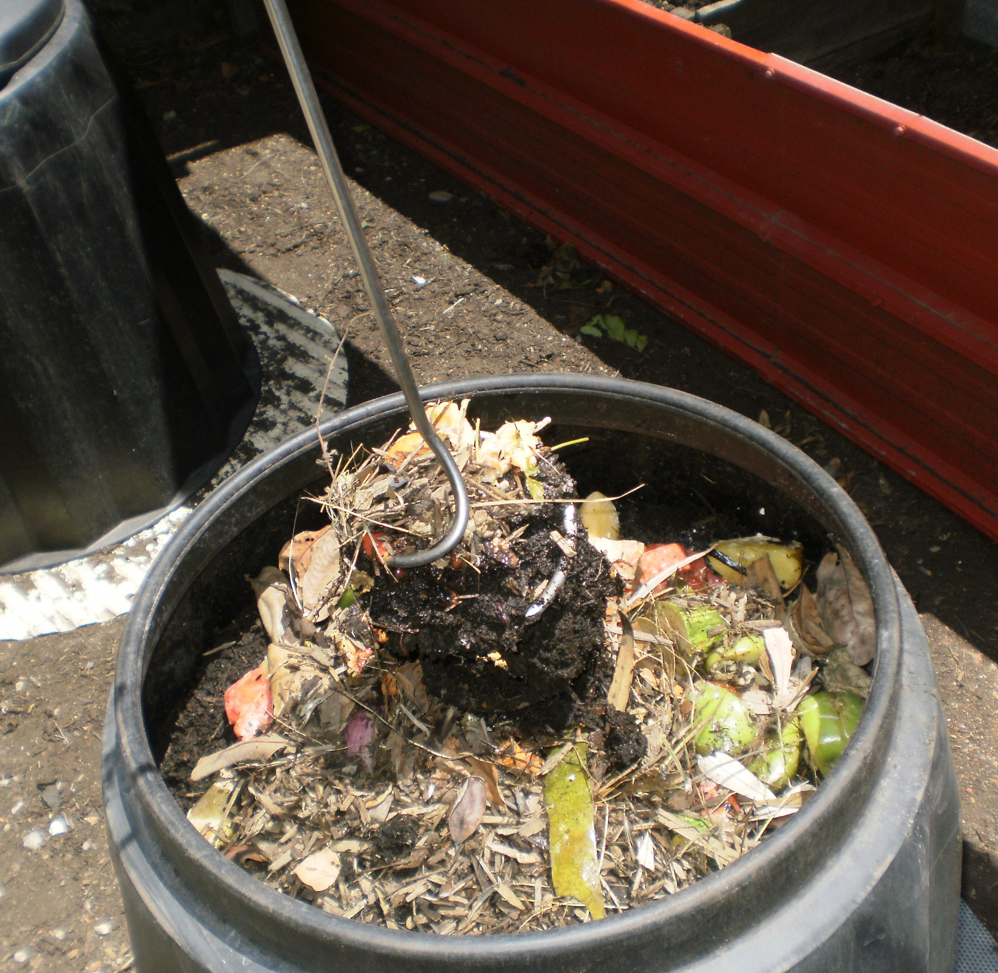
4. Mix the compost with the tool – check the entire heap is moist

Slide 7
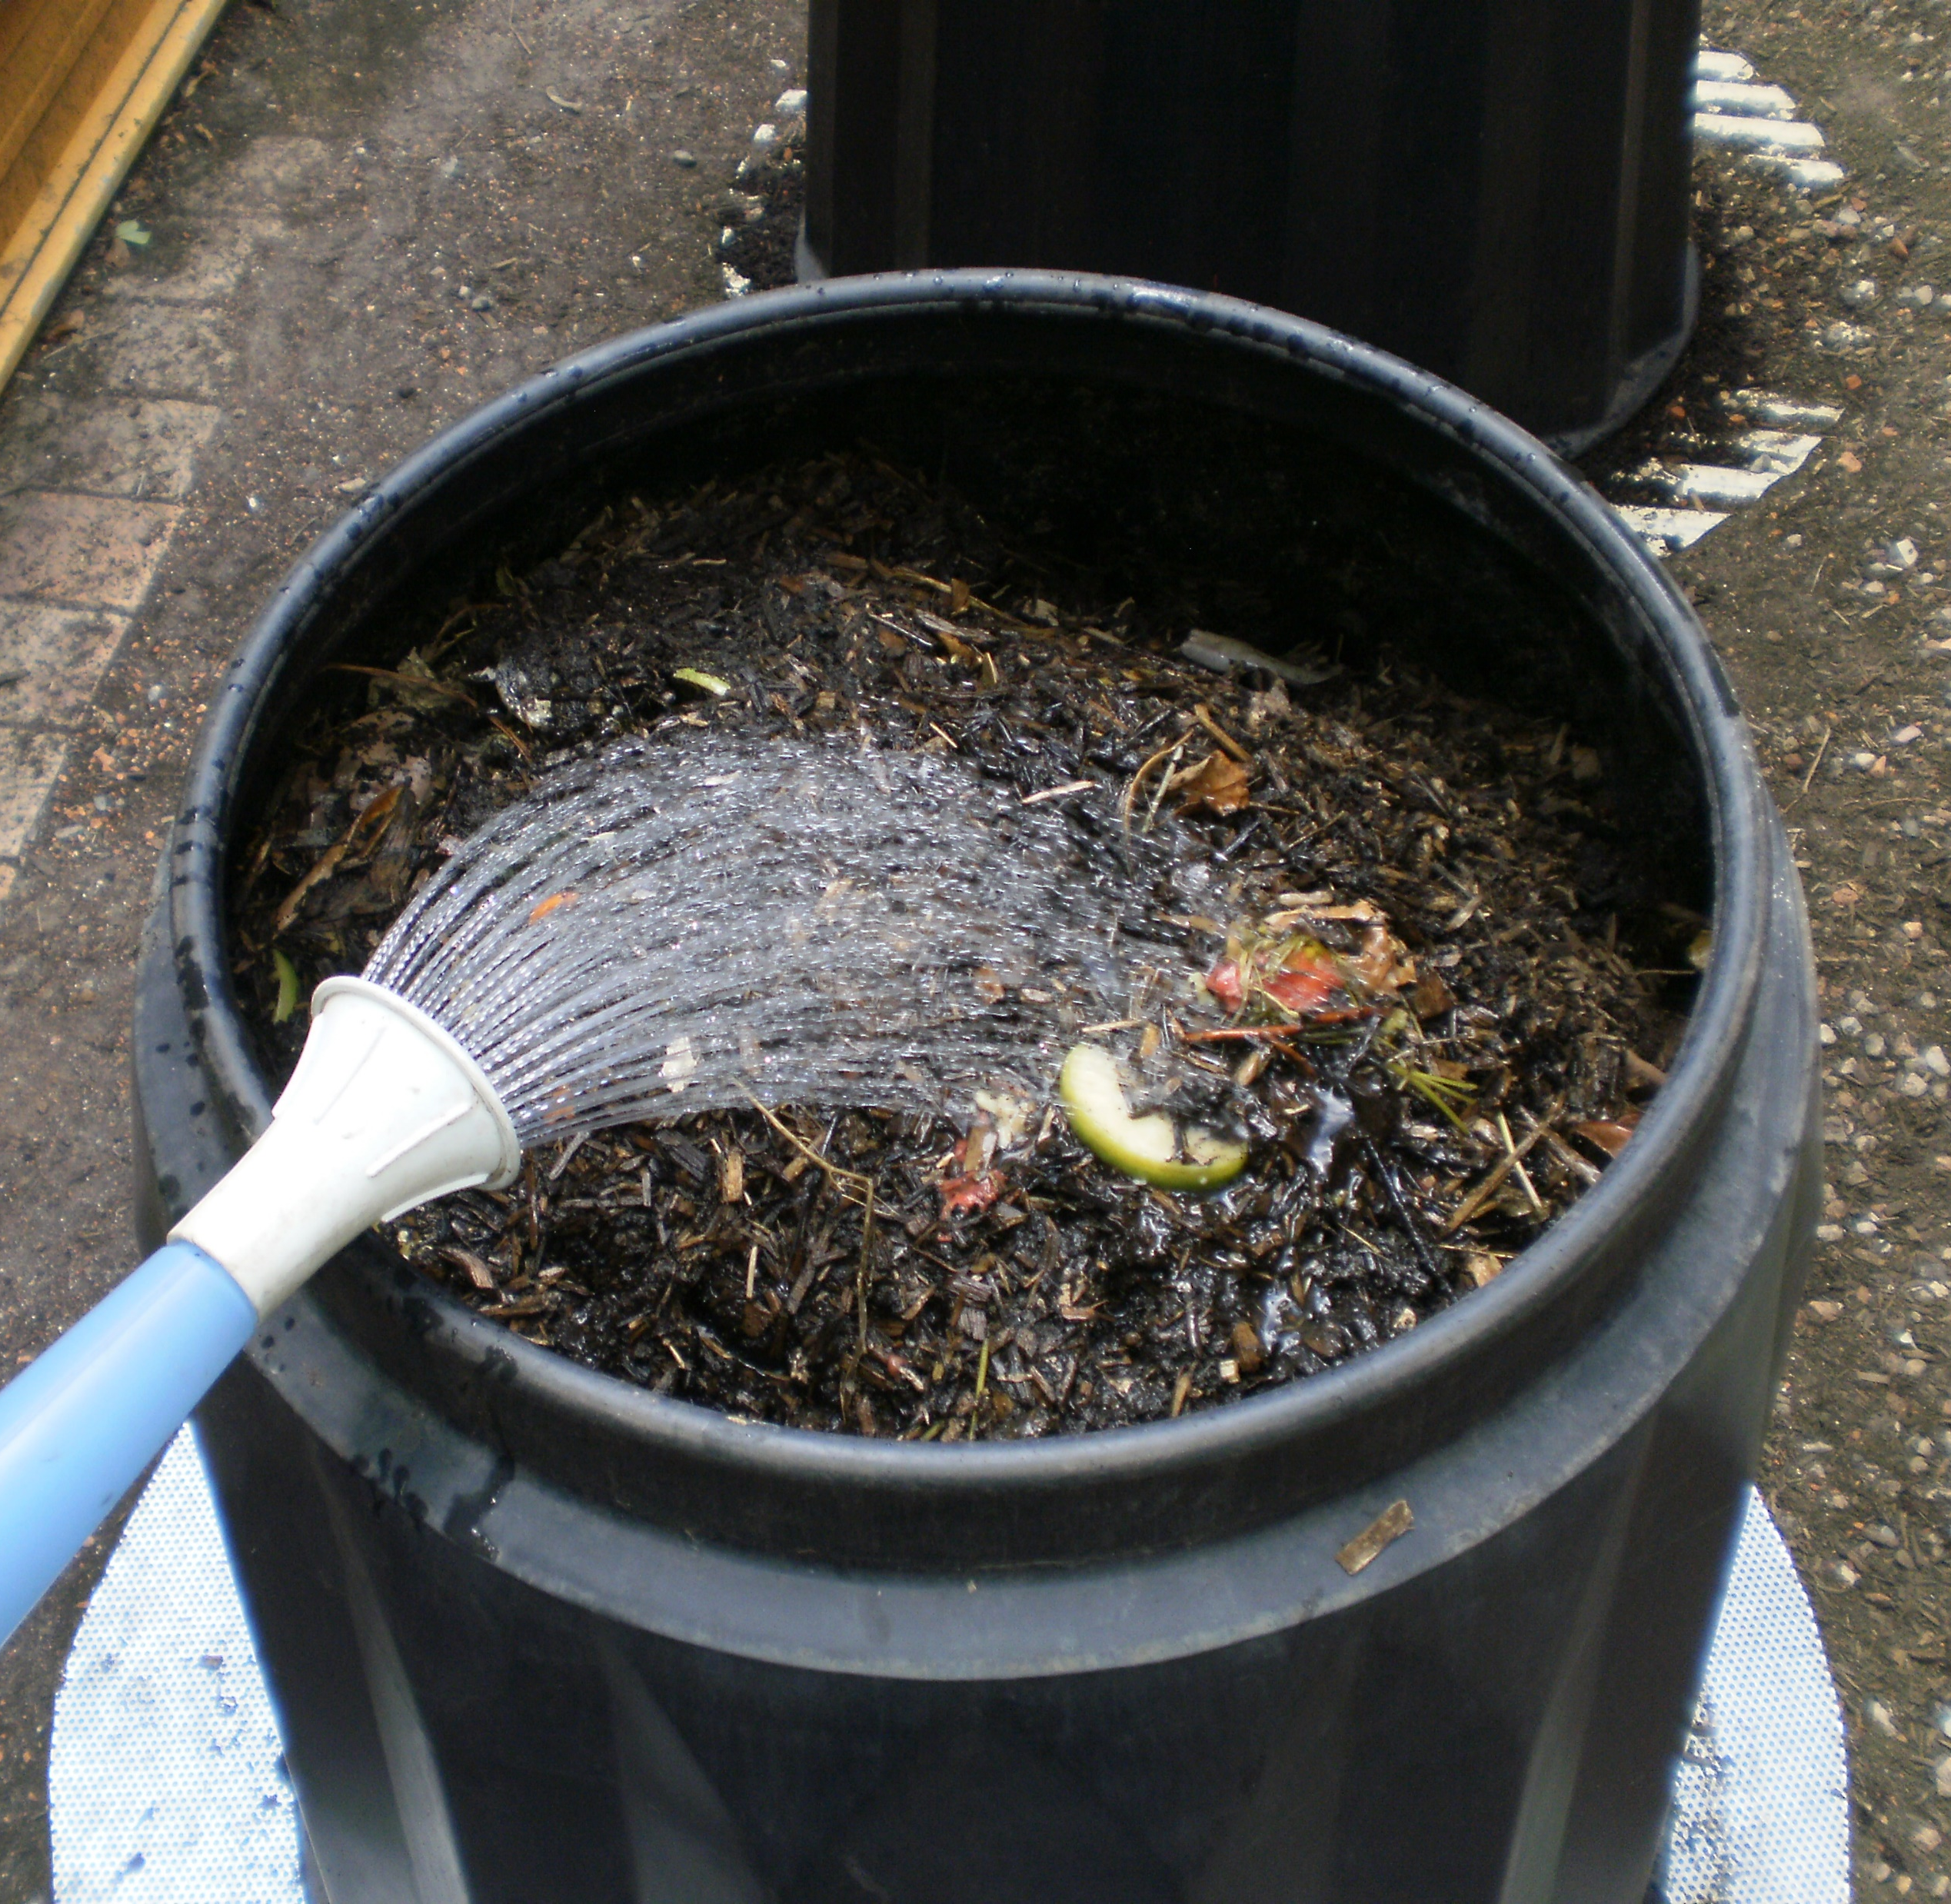
5. Water the compost if it looks dry
Imagine picking up some of the compost and squeezing it in your hand – if you can get a drop of water out it is wet enough, if not then it needs water.

Slide 8
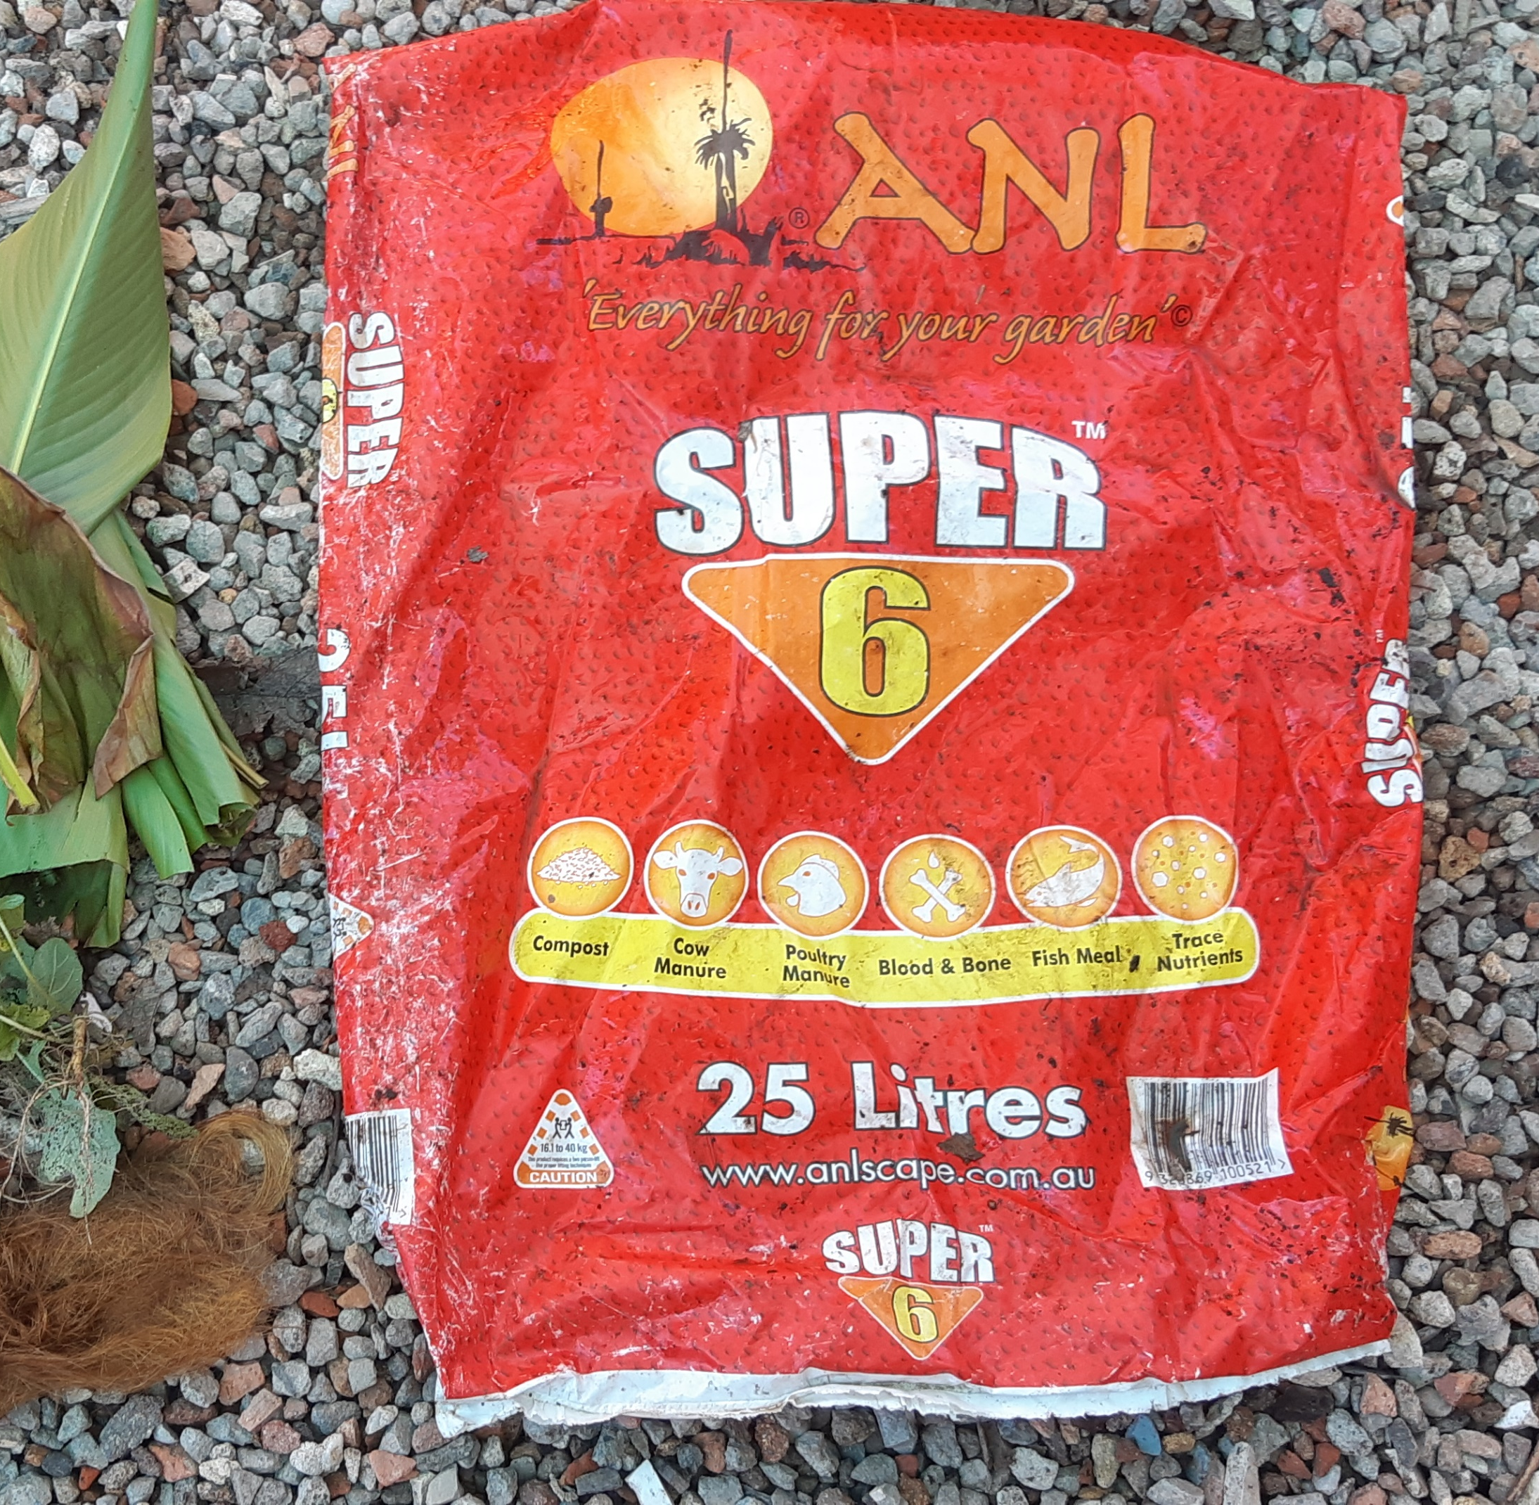
6. Add other ingredients regularly e.g. manures, hair, herbs, weeds, grass, soil
Diversity is the key!

Slide 9
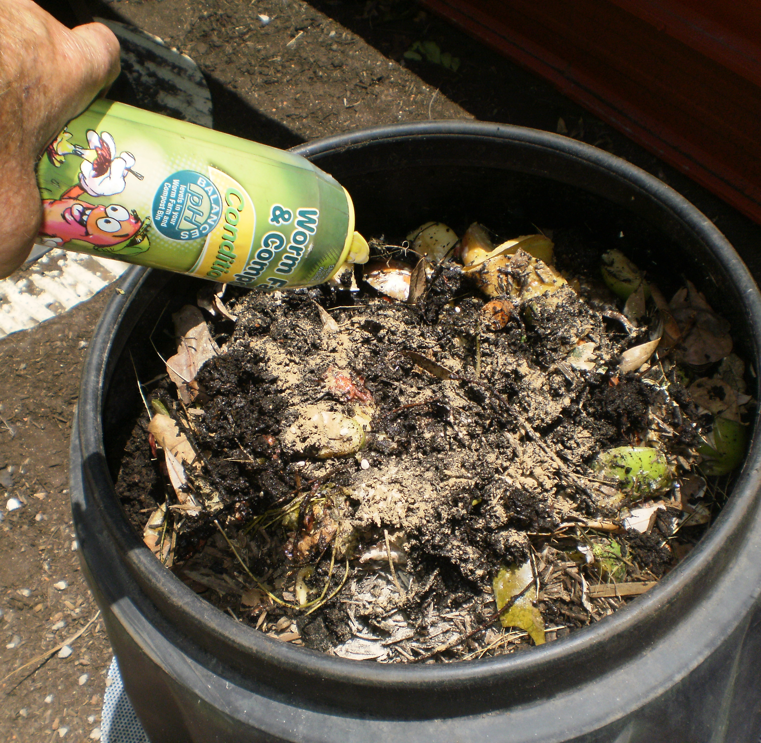
7. Add a teaspoon of dolomite lime or Worm Farm & Compost Conditioner weekly, to balance acidity

Slide 10
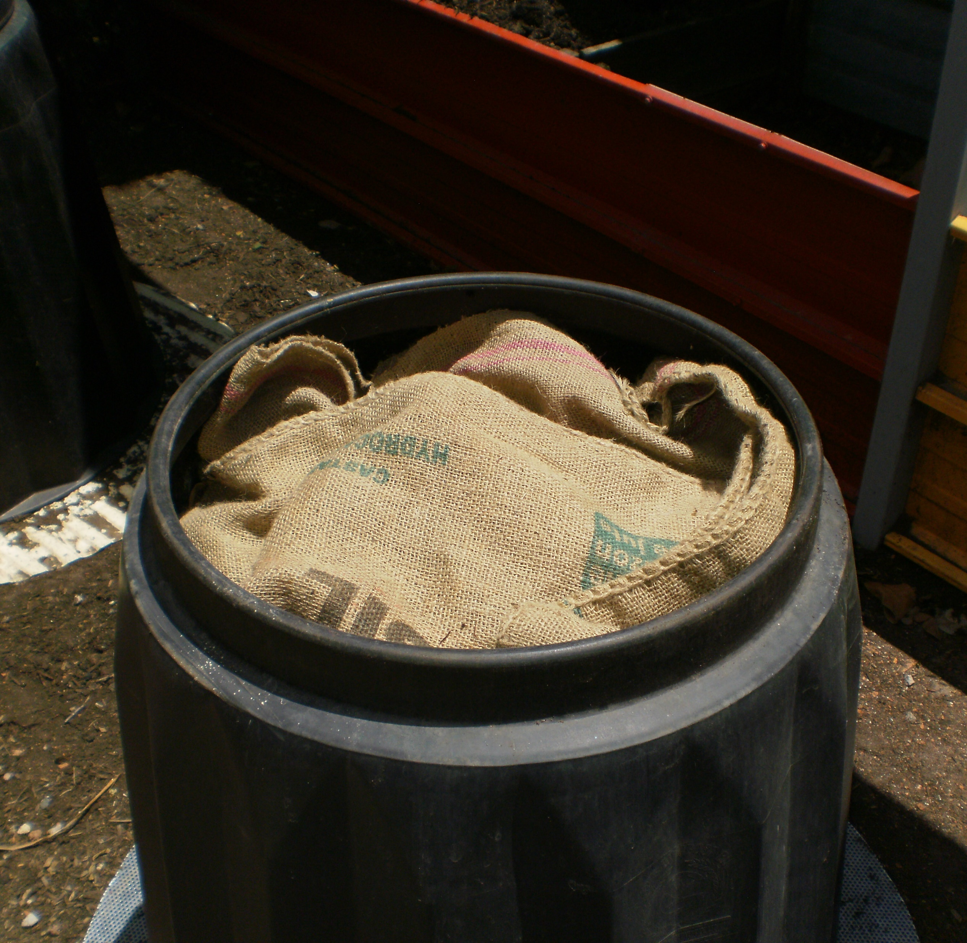
8. Put the blanket back on, as well as the lid, to keep the heap moist and dark

Slide 11
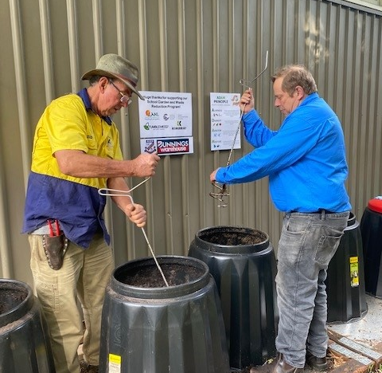
9. When bin is full it needs to mature for 6-8 weeks
Keep this maturing bin moist and mix it. Add a little dolomite lime weekly and pelletised manure weekly (optional).

Slide 12
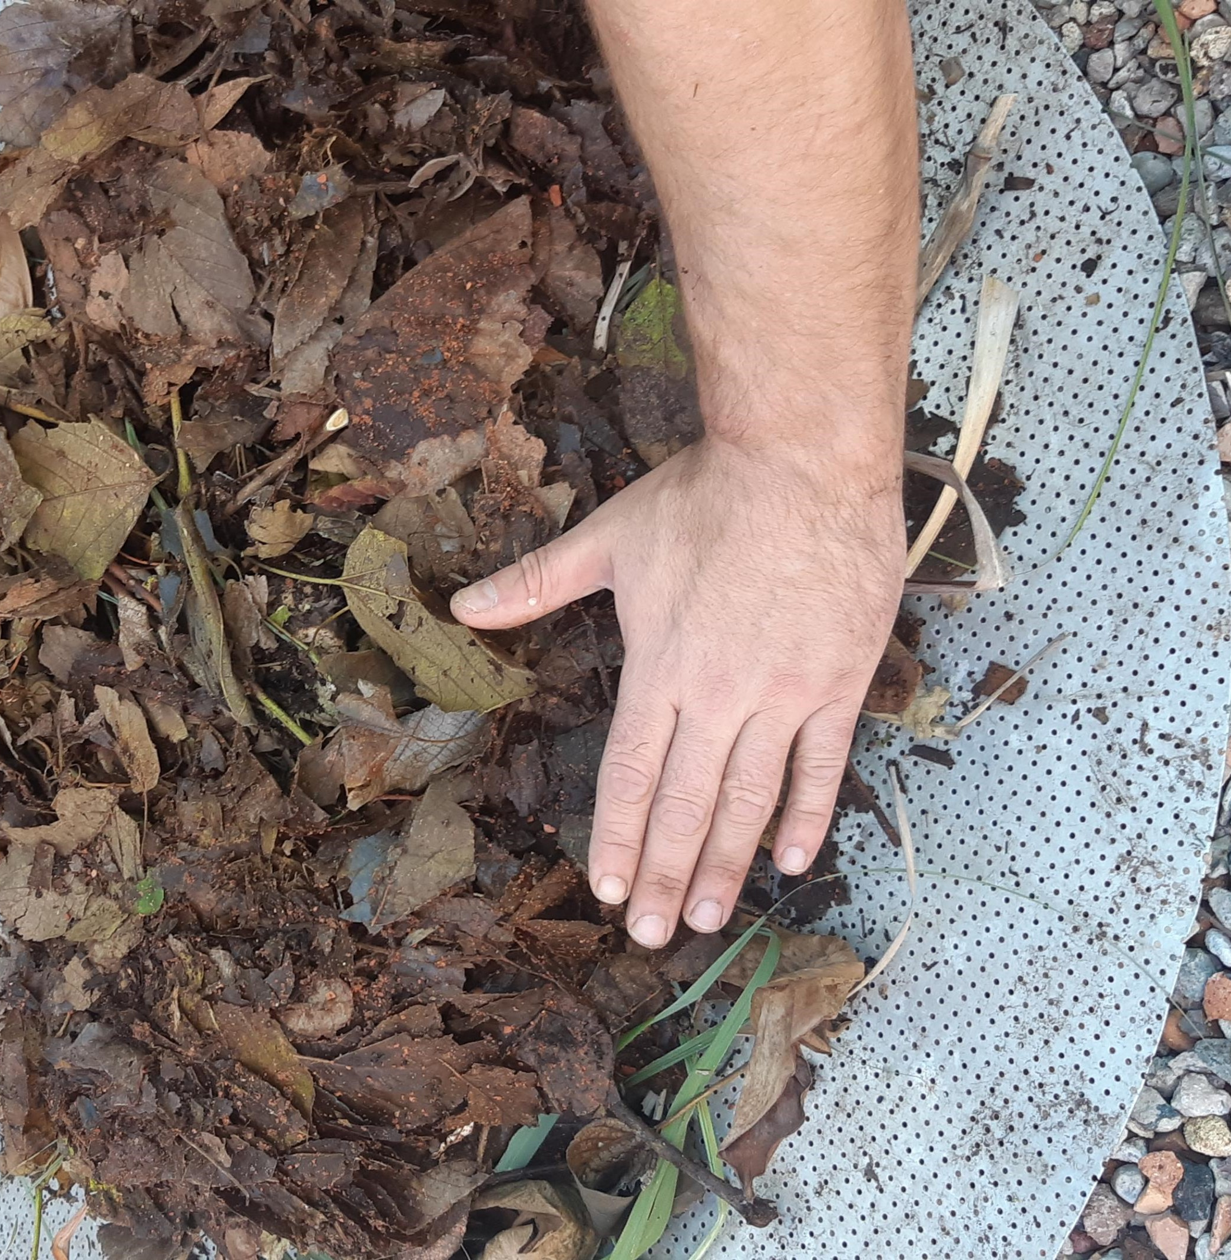
10. Start a new compost bin to continue recycling your food scraps

Slide 13


Acknowledgements

