Slide 1
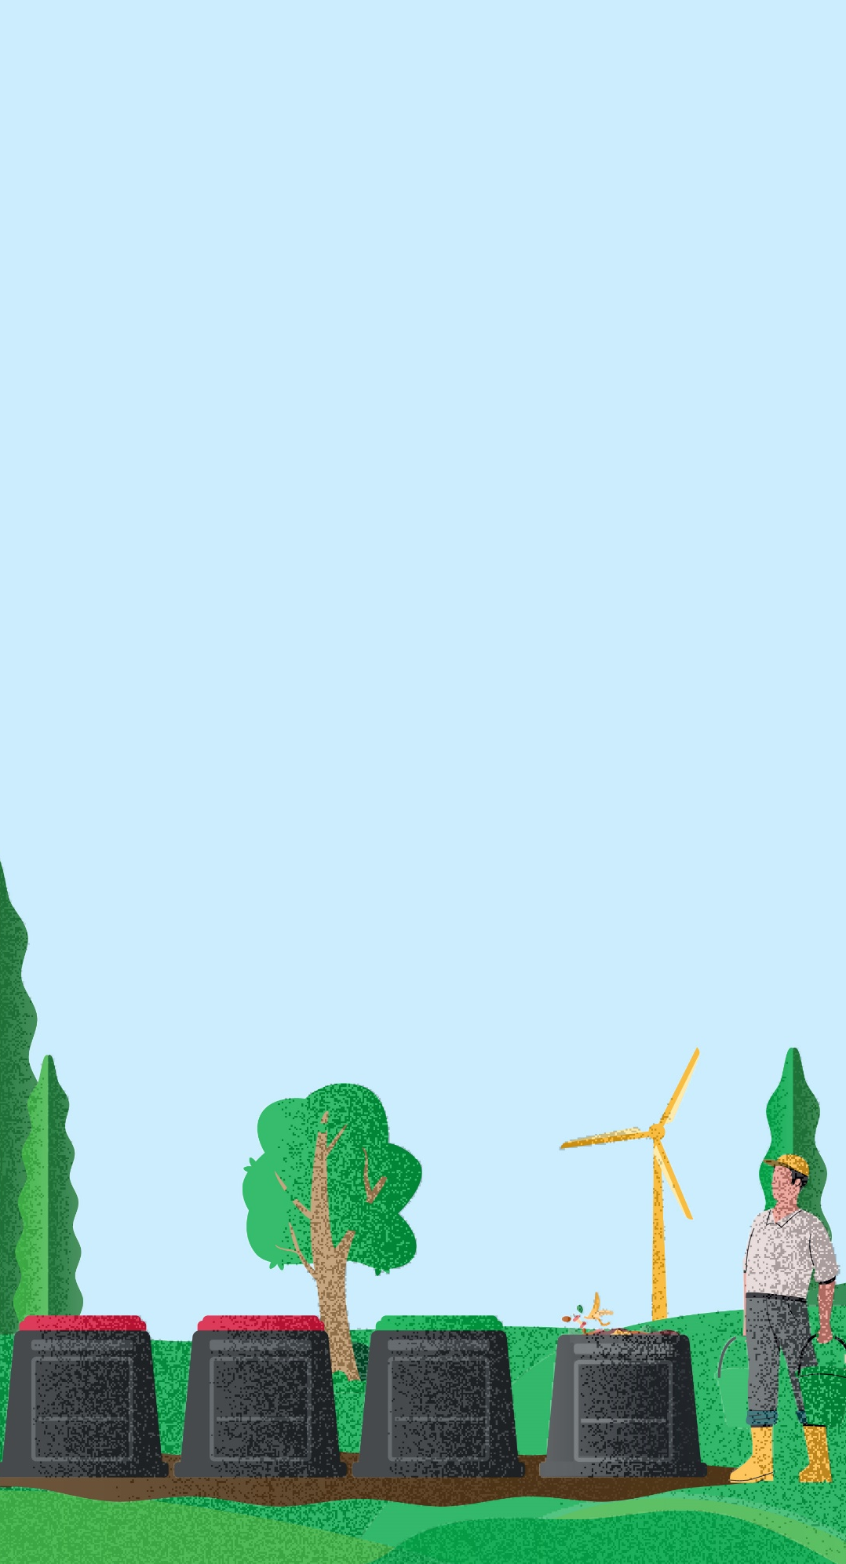
Setting up your compost
Managing an effective school compost system
Solving Organic Waste
DD Month 2025

Slide 2
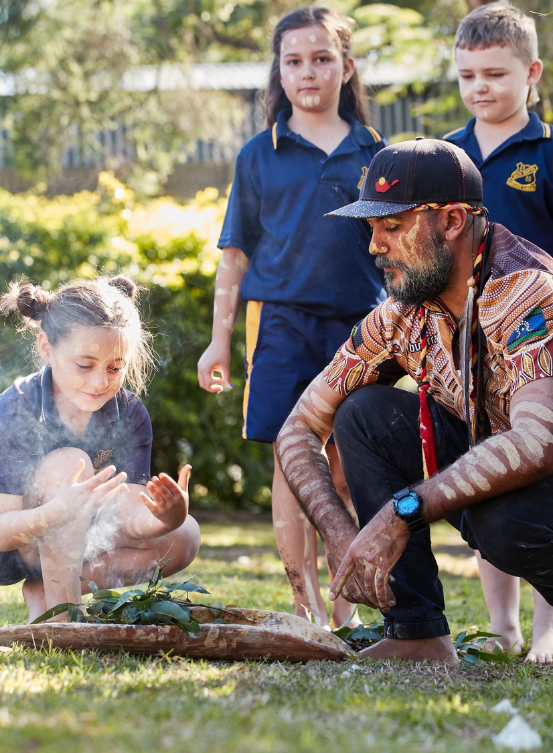
Acknowledgement of Country
We recognise the Ongoing Custodians of the lands and waterways where we work and live. We pay respect to Elders past and present as ongoing teachers of knowledge, songlines and stories.
We strive to ensure every Aboriginal and Torres Strait Islander learner in NSW achieves their potential through education.

Slide 3
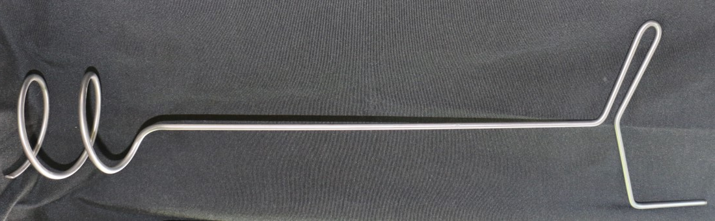
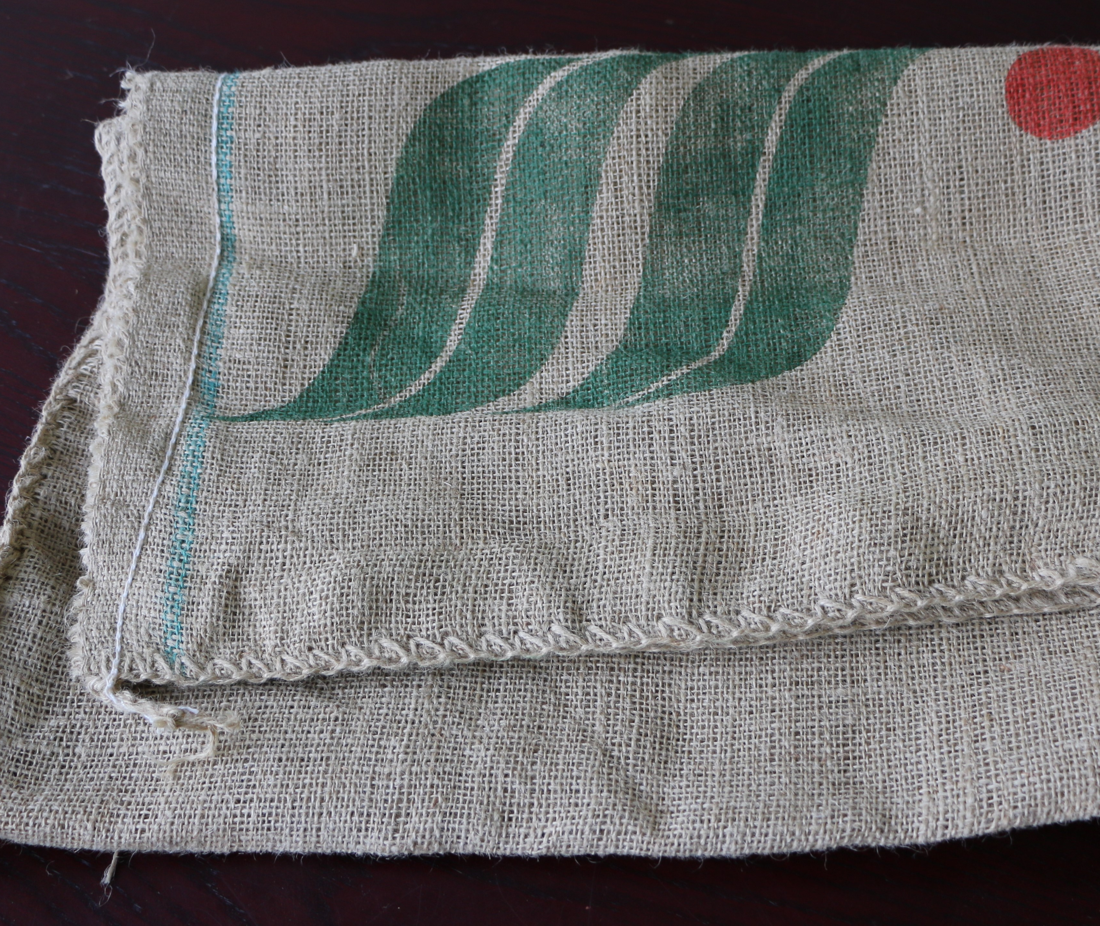
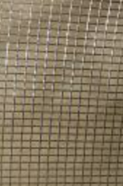
Equipment needed
Compost bins and lids
Compost spiral mixing tool
Garden lime/dolomite/Worm Farm & Compost Conditioner
Rodent proof barrier
Hessian sacks or compost blankets
Woody mulch/twigs/dry leaves
Access to water
Gloves.

Slide 4
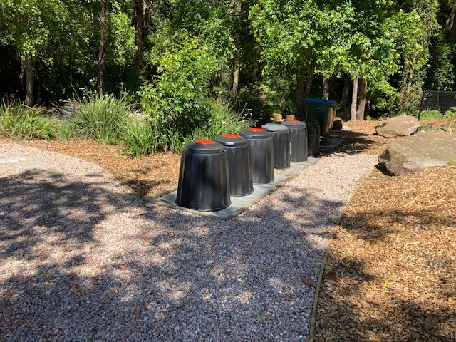
1. Choose an accessible and flat area with enough space for at least 3 compost bins
There also needs to be adequate room to store woody mulch and other coarse materials used in composting.

Slide 5
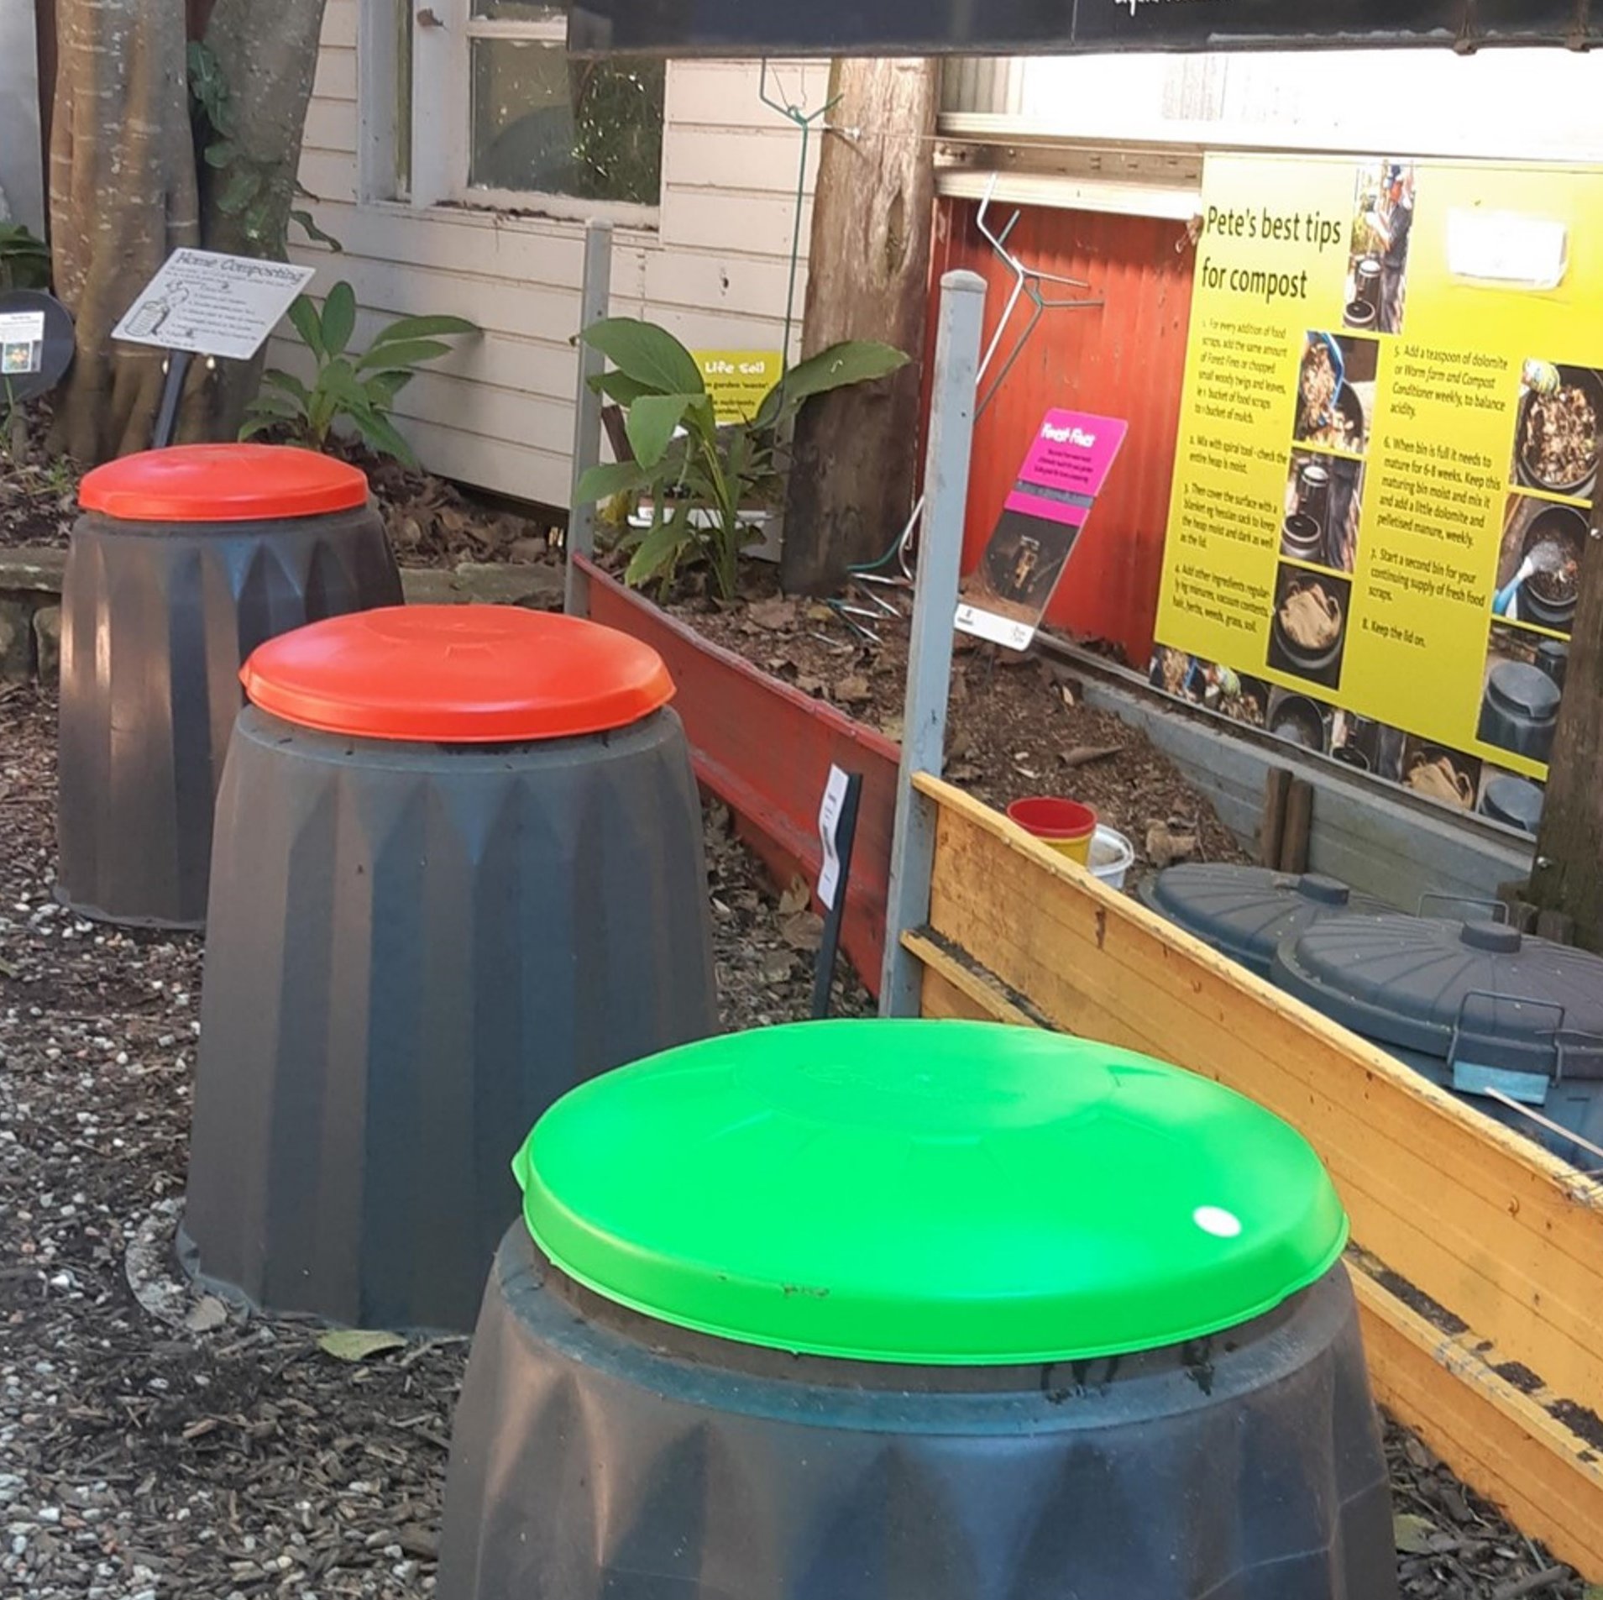
2. Colour-coded compost bin lids.
A vital idea for schools!
GREEN: food scraps and garden mulch → IN
RED: mature compost → OUT

Slide 6
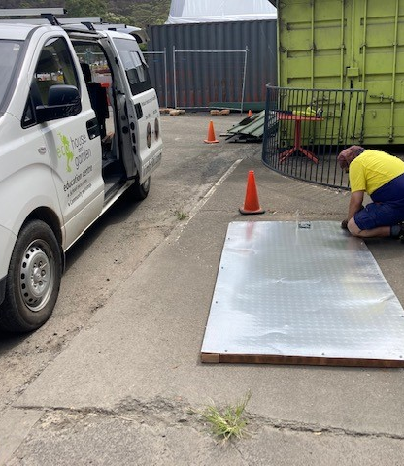
3. To prevent rodents use perforated galvanized metal sheeting to place compost bins on top of
An alternative is Snake and Mouse wire mesh but this will rust and need replacing every couple of years

Slide 7
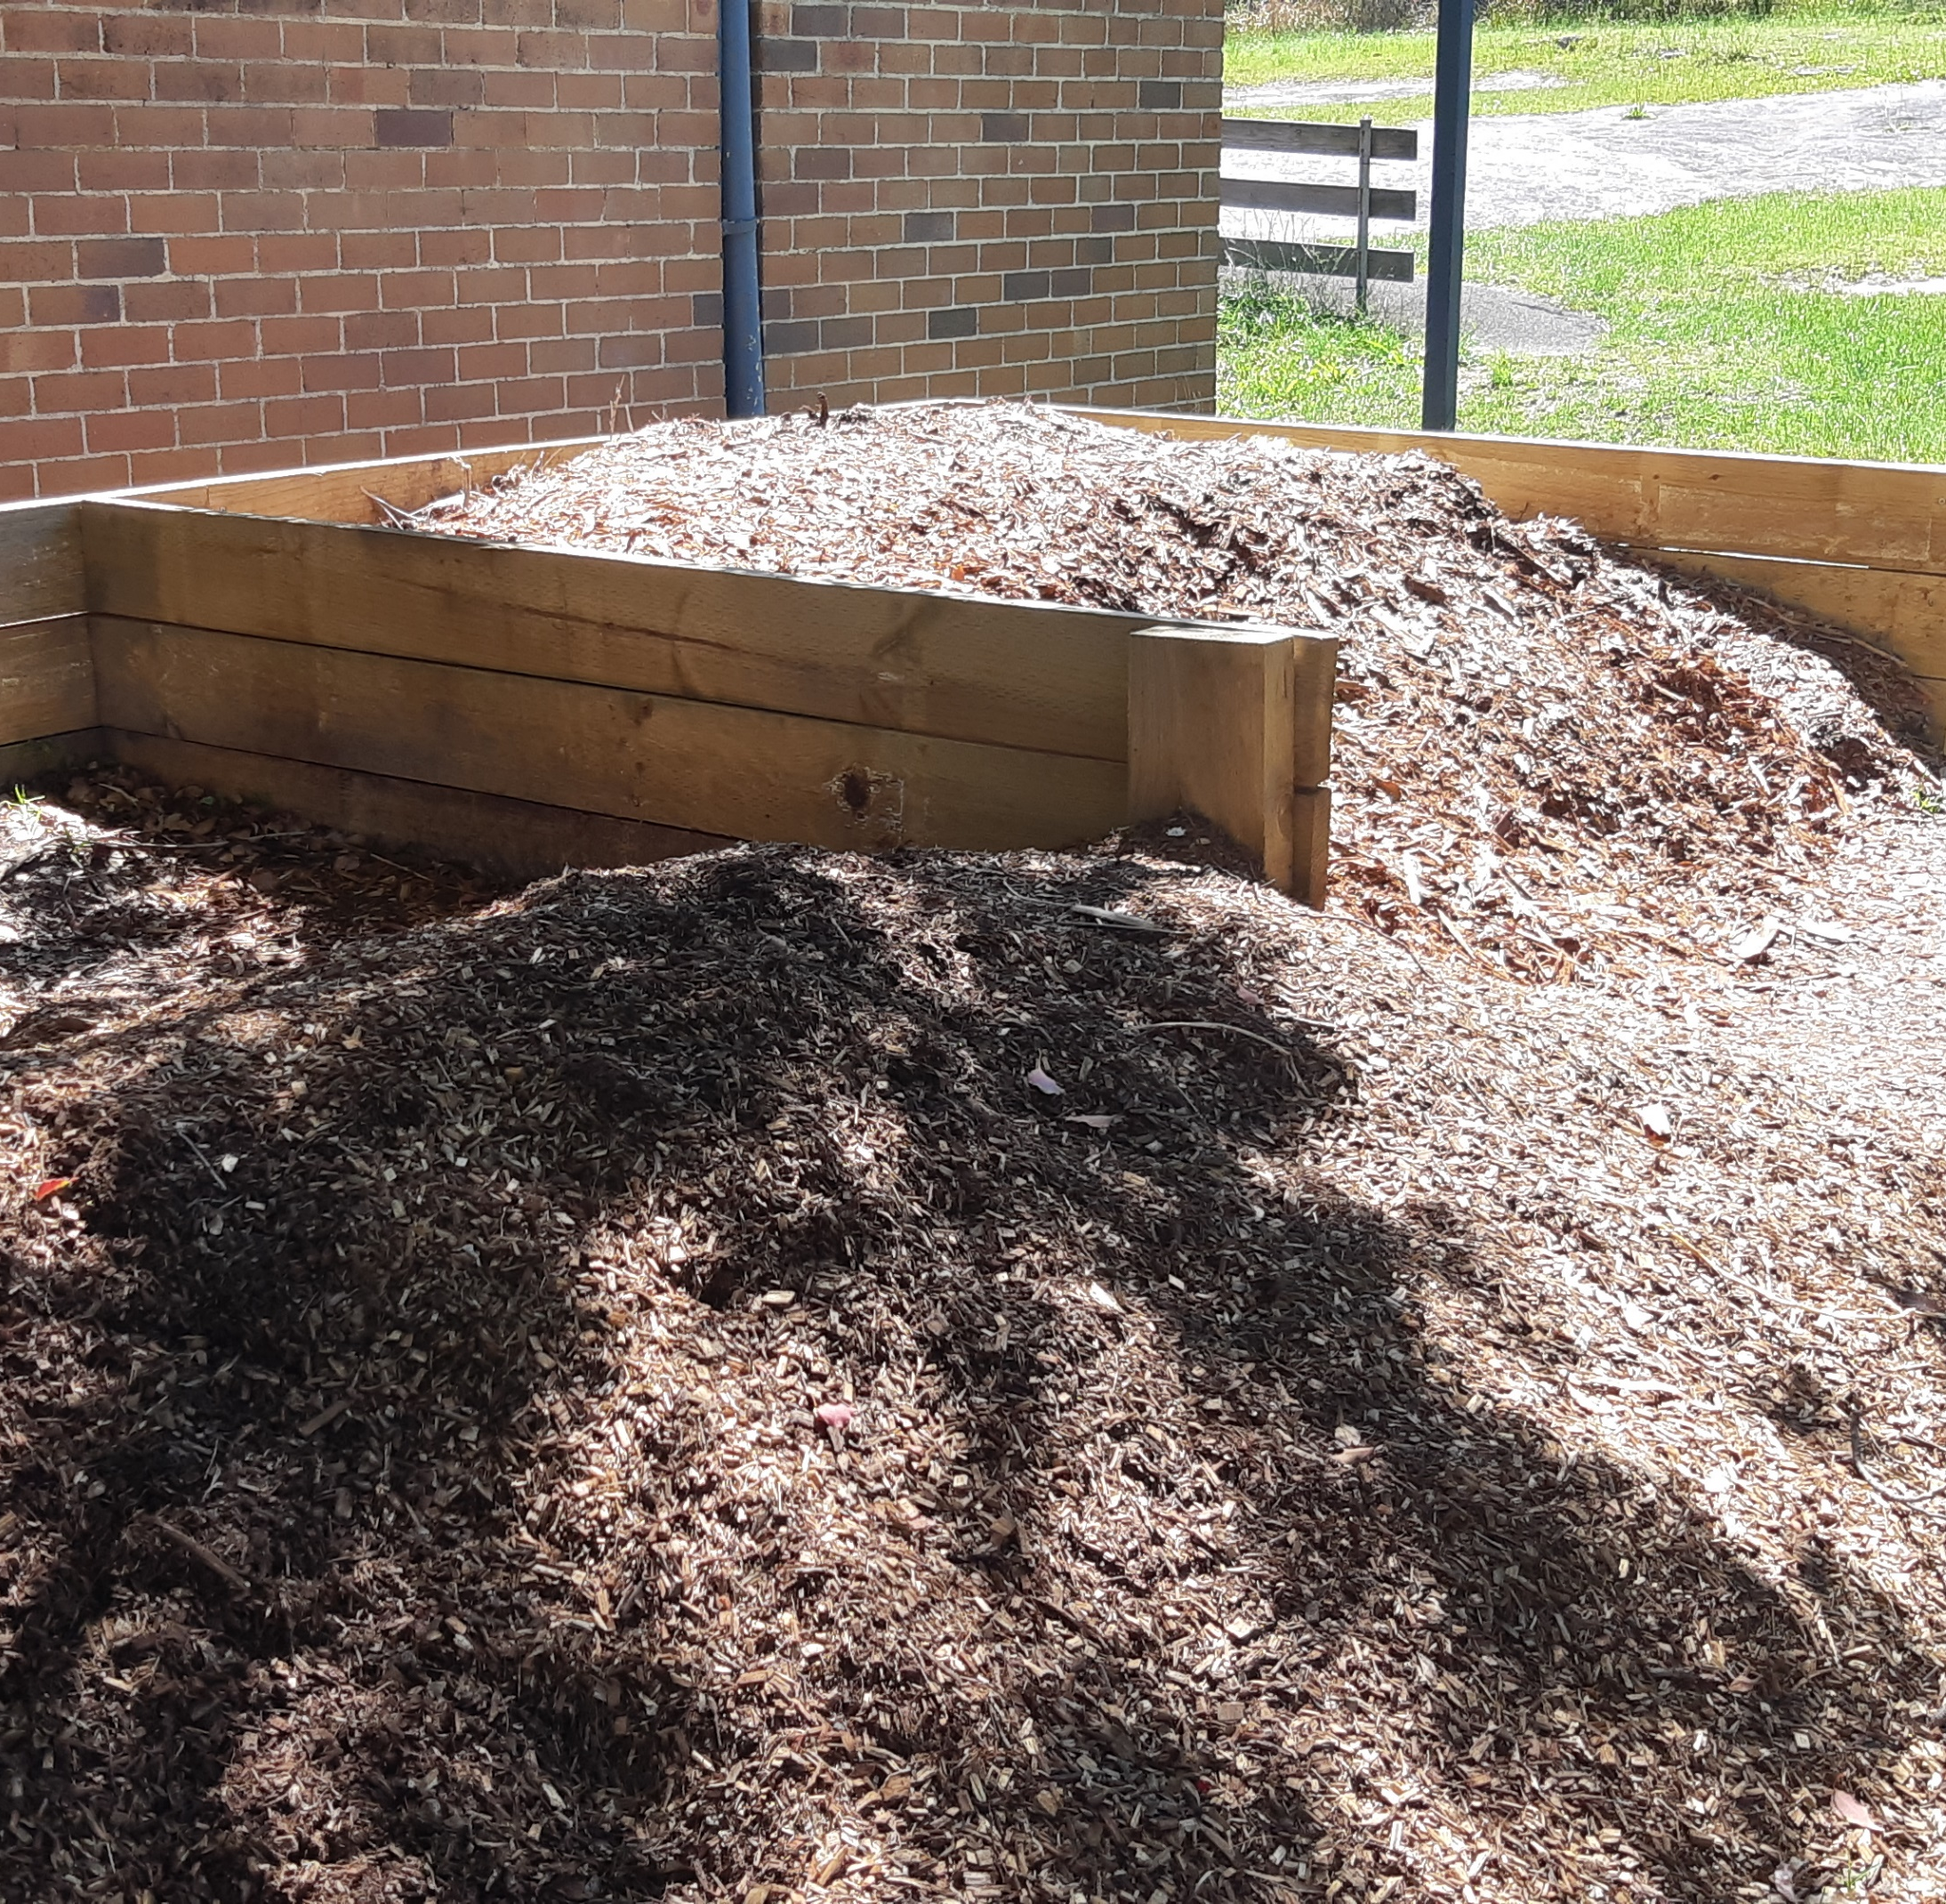
4. Ensure an adequate space for the storage and delivery of fine woody mulch

Slide 8
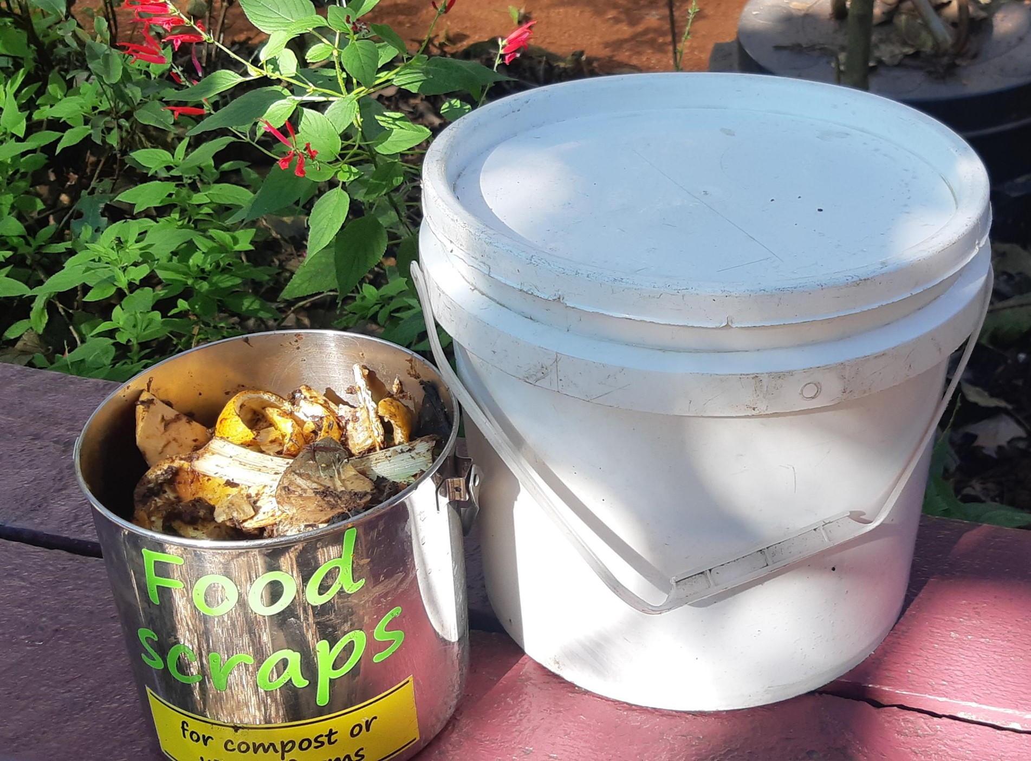
5. You will need collection buckets with lids to collect the food scraps in various places around your school

Slide 9
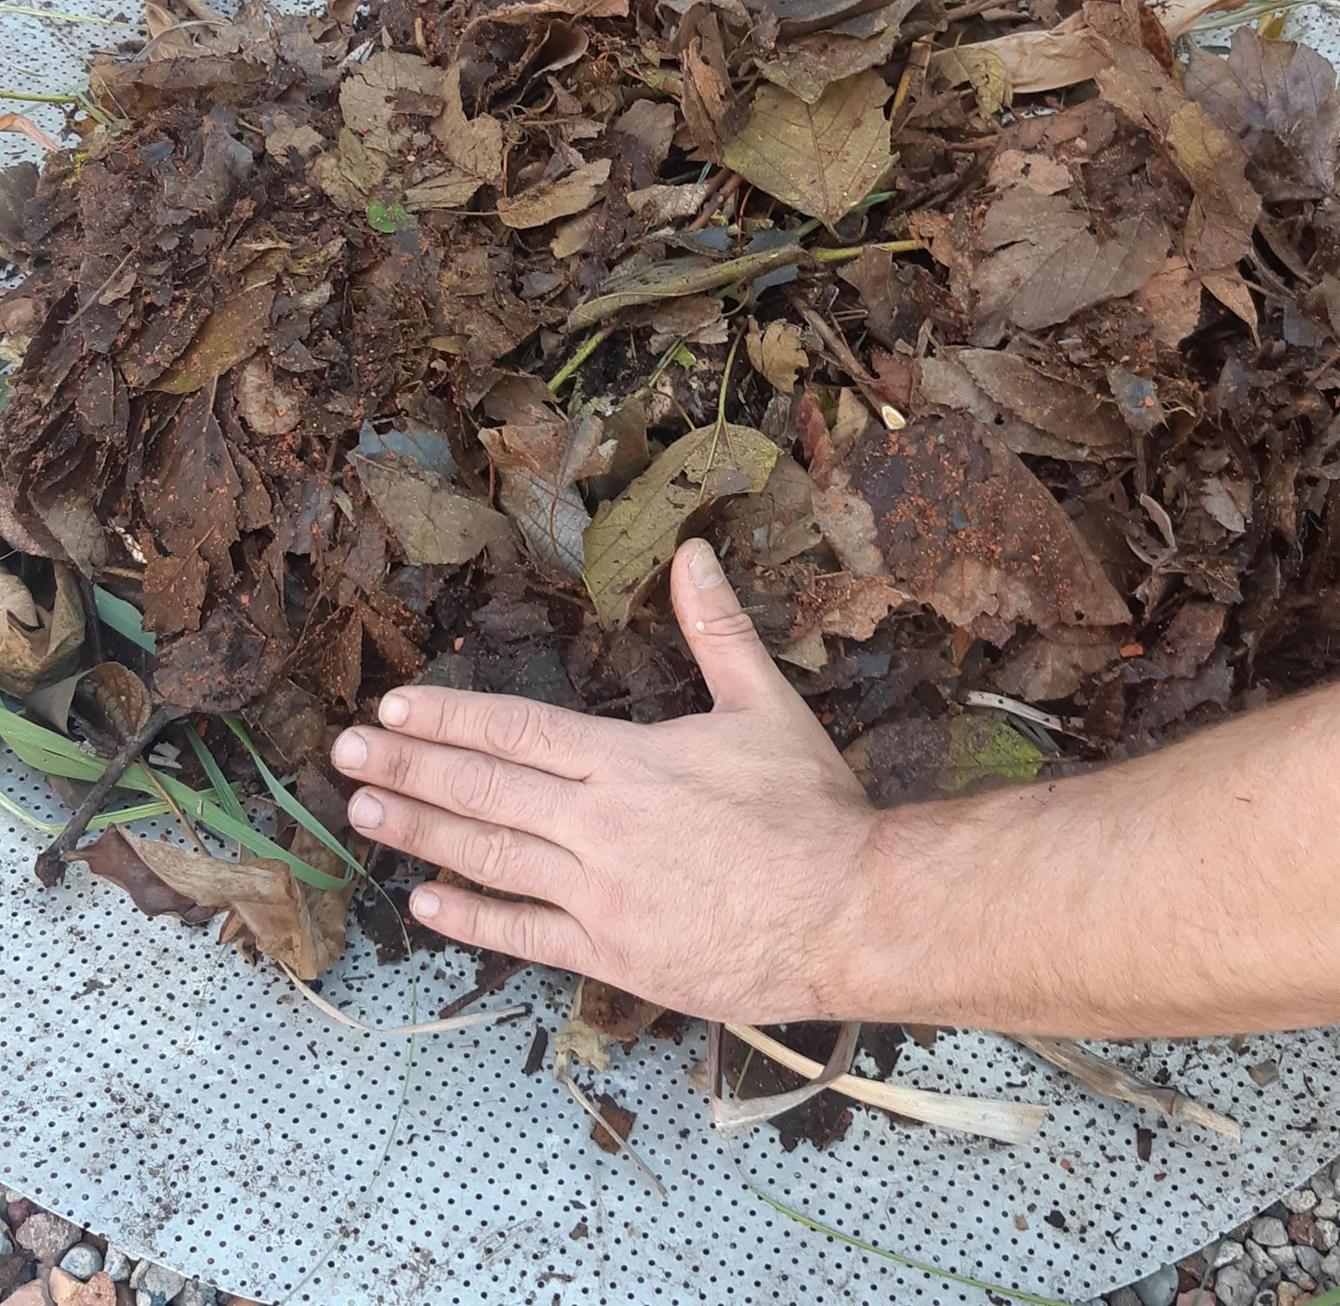
6. To set up your first compost bin, place a layer of woody mulch in the bottom of the compost bin
Add a hand’s width (10-15cm) and water generously.

Slide 10
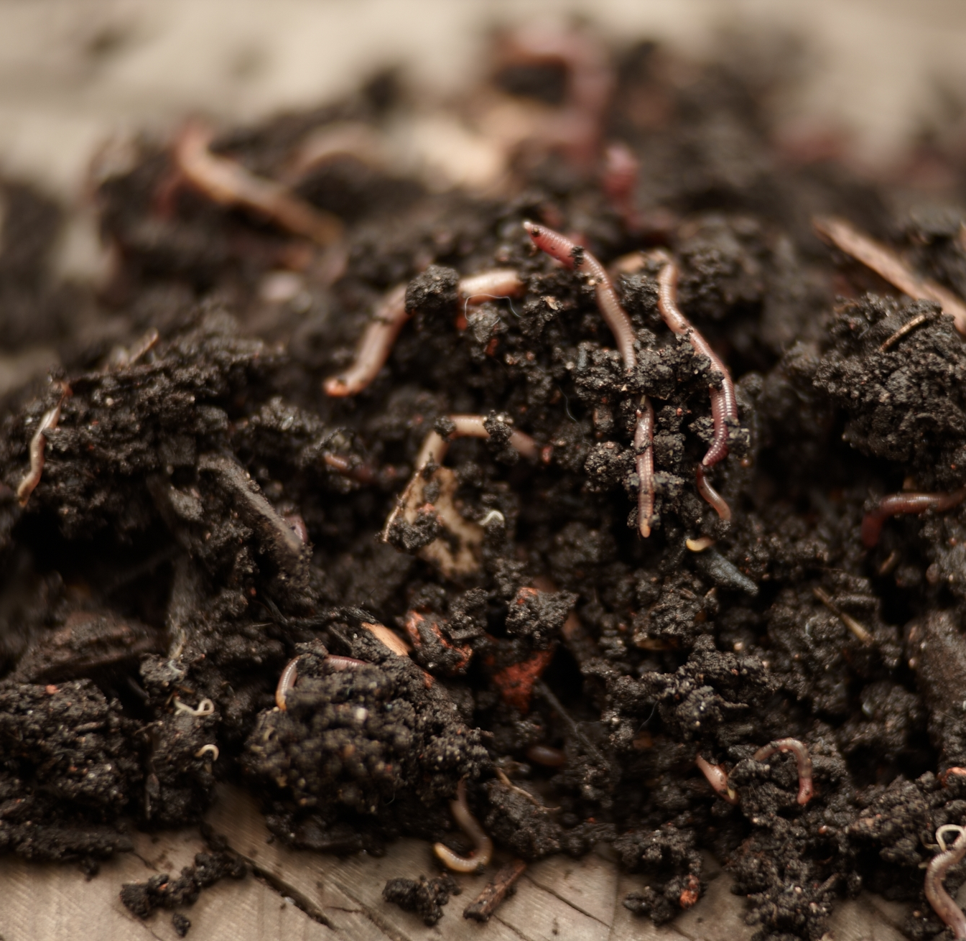
7. ‘Seed’ the compost bin with some rich alive soil or mature compost

Slide 11
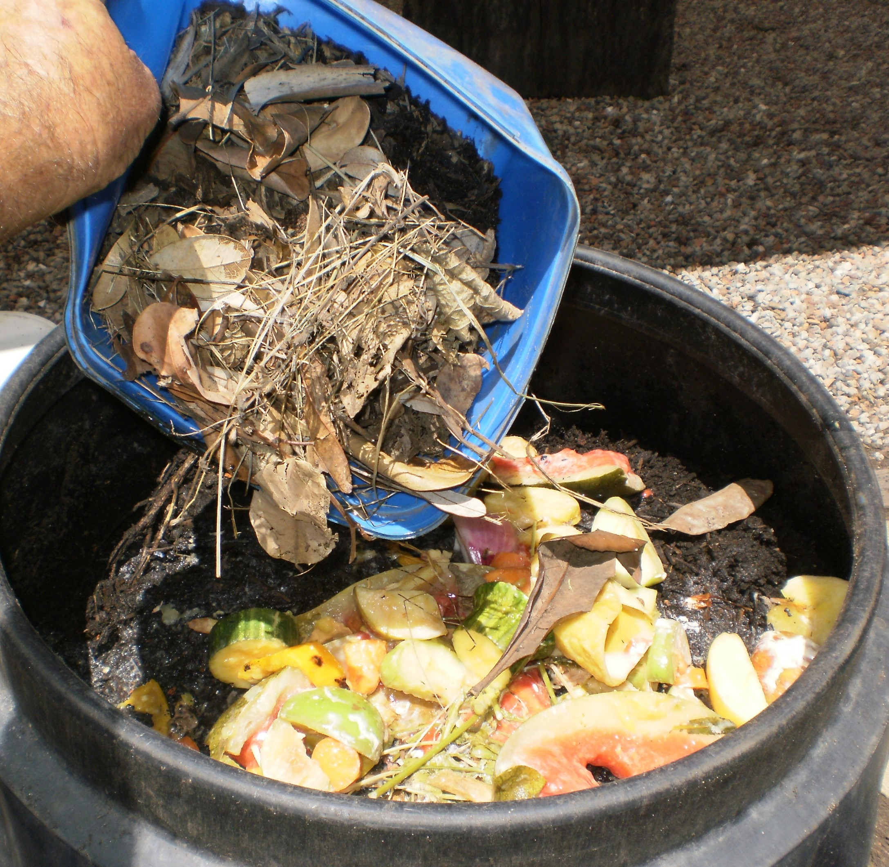
8. Now you are ready to start adding food scraps and following the Compost Recipe and ADAM principles
This compost bin will have a GREEN lid and is a FEED ME or GO BIN.

Slide 12
9. Managing your compost with the ADAM principles
Aliveness - worms & microscopic organisms are doing all the work!
Diversity - variety is the spice of life!
Aeration - worms & microscopic organisms breathe!
Moisture - keep the compost heap moist all the time!

Slide 13
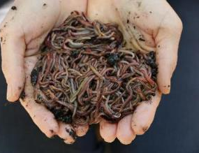

Aliveness – respect for all life, seen and unseen

Slide 14
Diversity (variety) – a 50/50 mix of food scraps and garden mulch

Slide 15
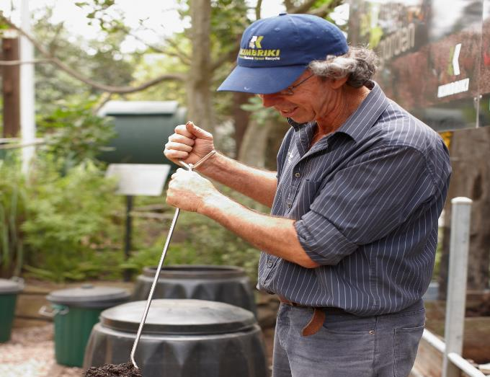
Air. Mix mix mix. Aeration is Key

Slide 16
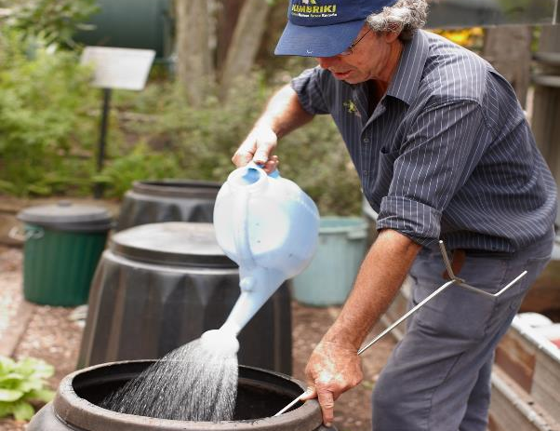
Moisture. Add enough so the compost is like a damp sponge

Slide 17
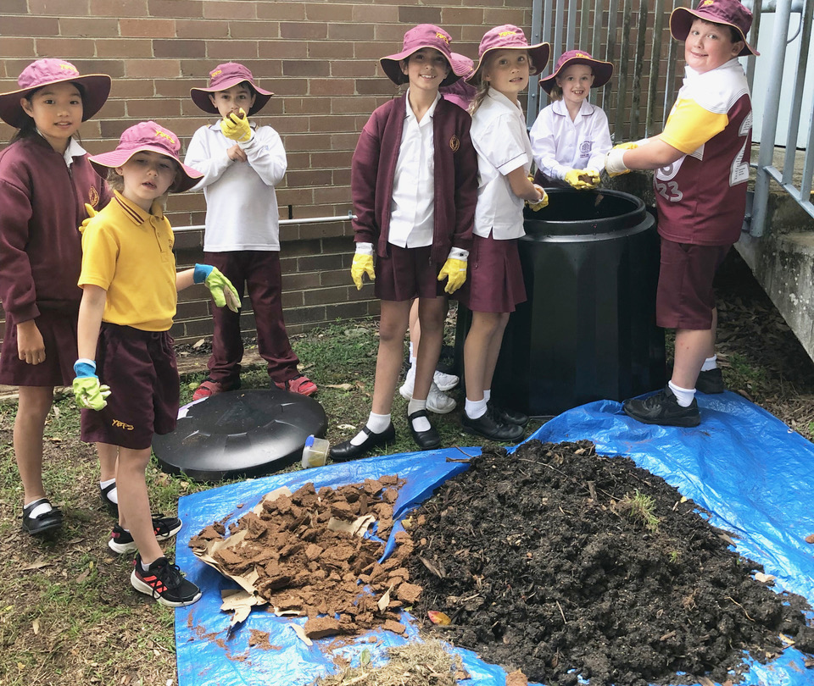
Mature compost
When this bin is full it needs to mature for 6-8 weeks.
Change the lid to a RED LID.
Keep this maturing bin MOIST AND MIX IT and add a little dolomite lime weekly.
Optional - add pelletised manure WEEKLY
When it looks like beautiful rich dark soil it can be added to your school gardens.

Slide 18


Acknowledgements

