Slide 1

Resting your compost
Closing down a compost system for the holiday period
Solving Organic Waste
DD Month 2025

Slide 2
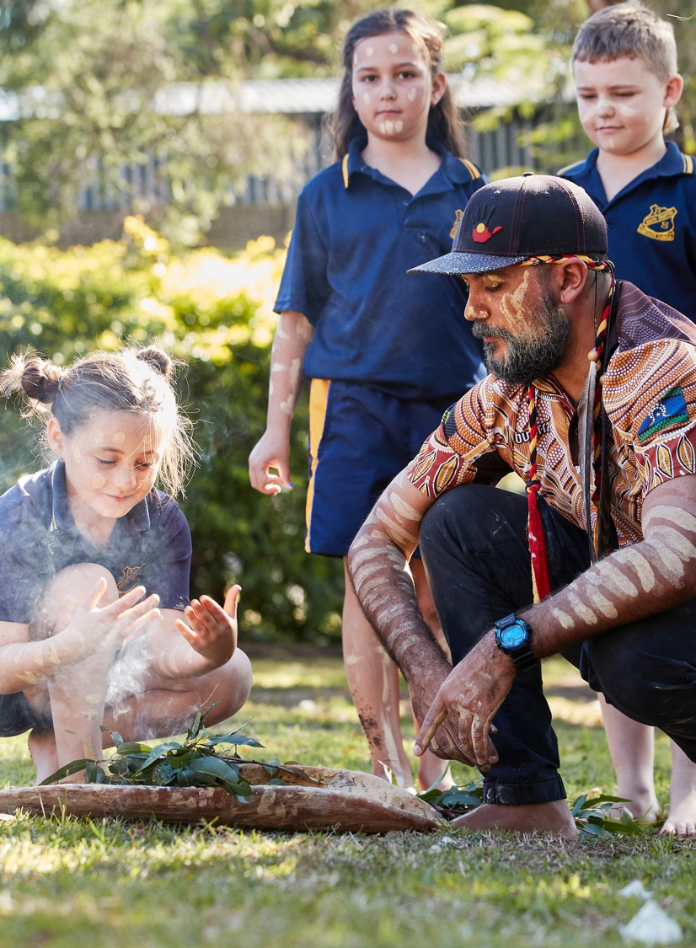
Acknowledgement of Country
We recognise the Ongoing Custodians of the lands and waterways where we work and live. We pay respect to Elders past and present as ongoing teachers of knowledge, songlines and stories.
We strive to ensure every Aboriginal and Torres Strait Islander learner in NSW achieves their potential through education.

Slide 3
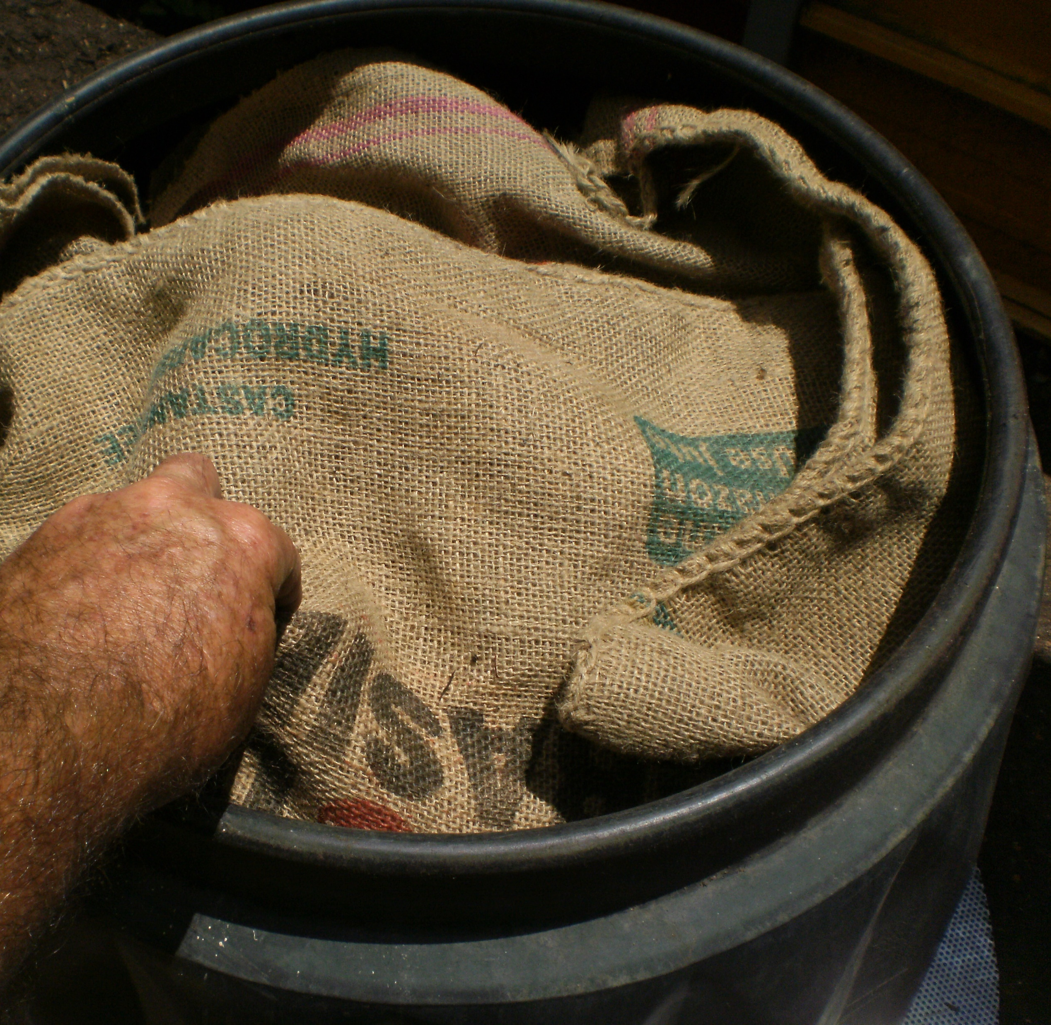
1. Remove lids and blanket covers

Slide 4
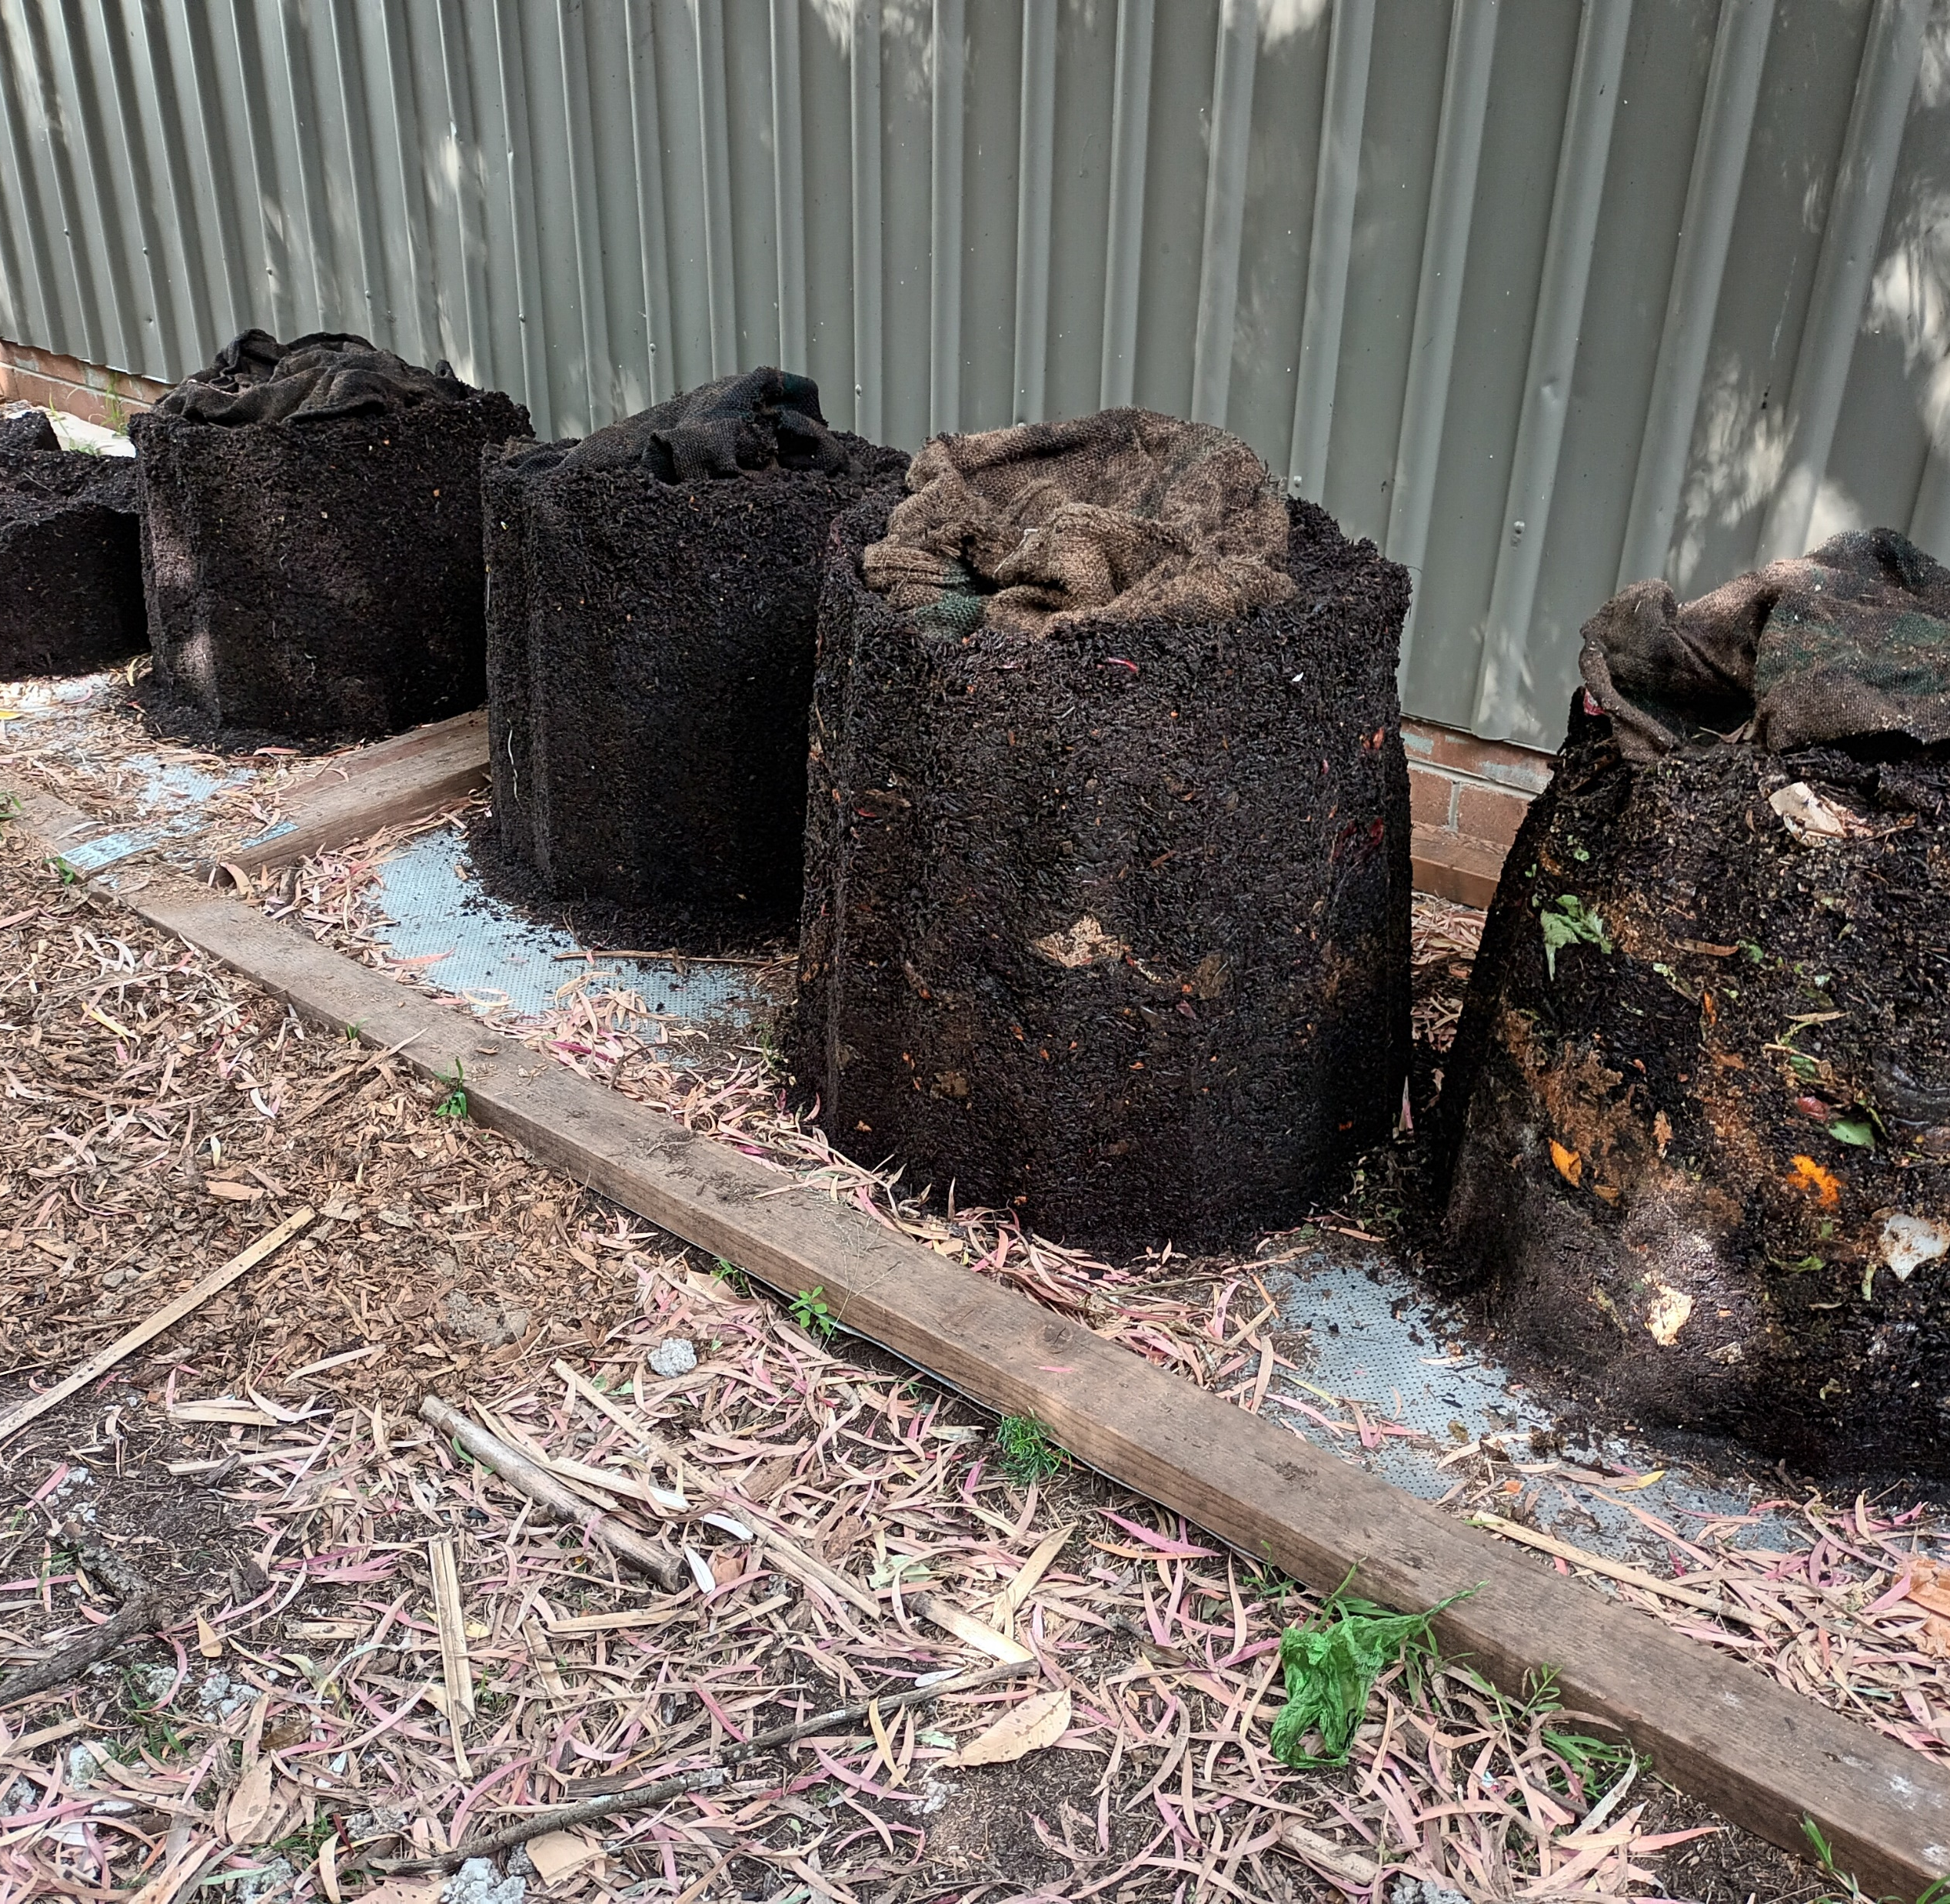
2. Before mixing, lift off bins to inspect progress of entire heap
Put bins back on.

Slide 5
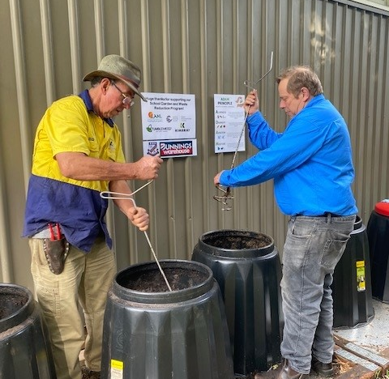
3. Initial mix, right to base, of all bins using spiral tools

Slide 6
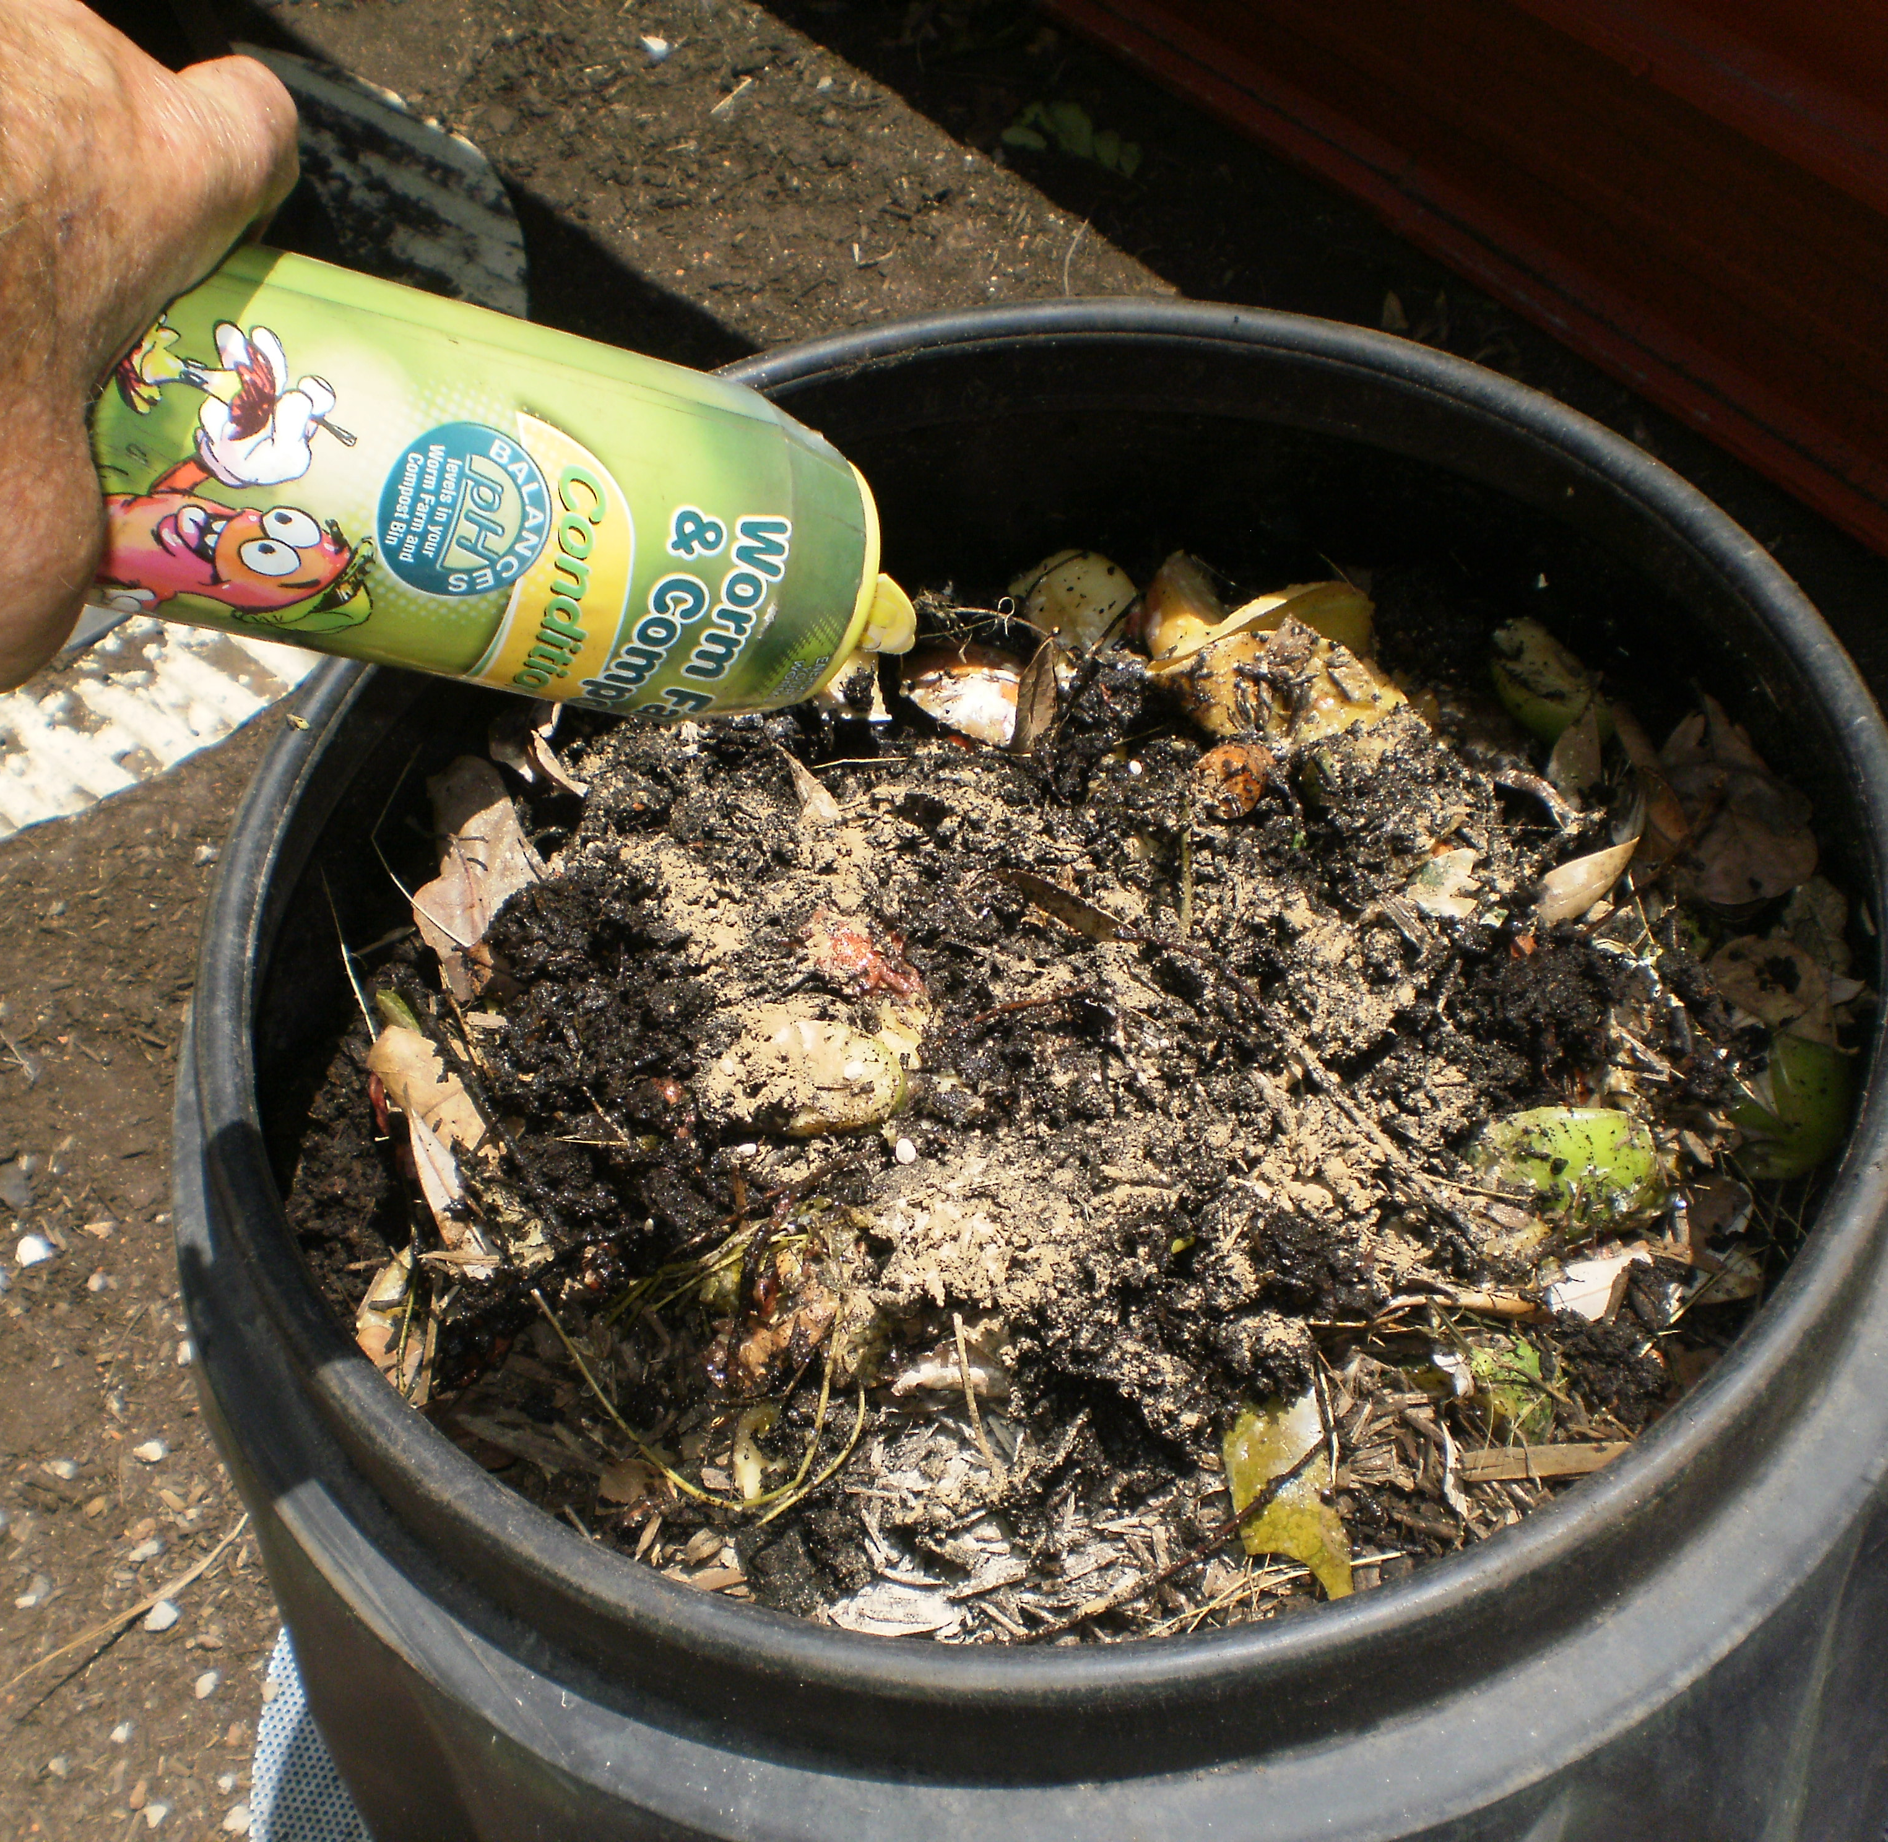
4. Add manure: 5 litres per bin

Slide 7
5. Add Dolomite lime (conditioner): 1 handful per bin

Slide 8
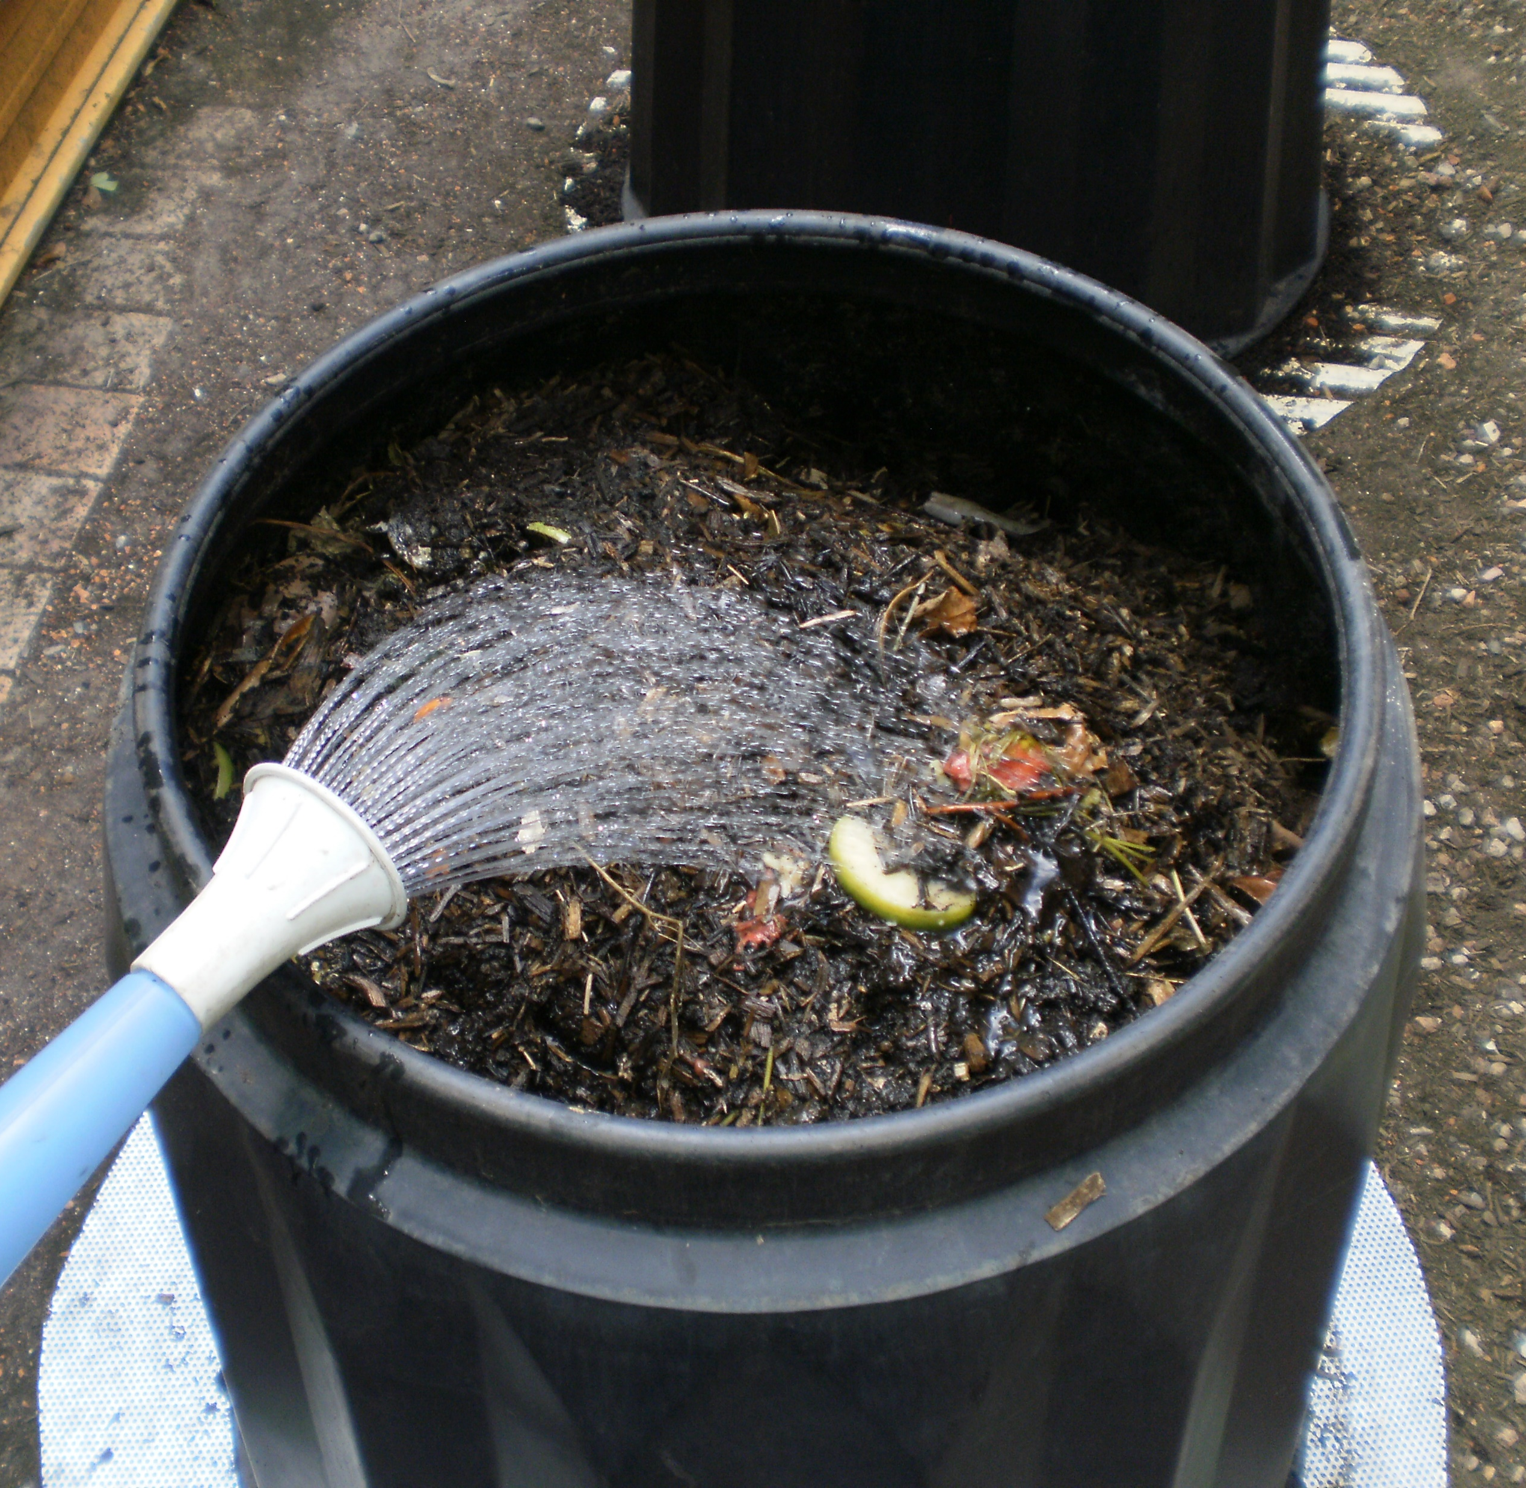
6. All bins: water really well and mix really well using spiral tools

Slide 9
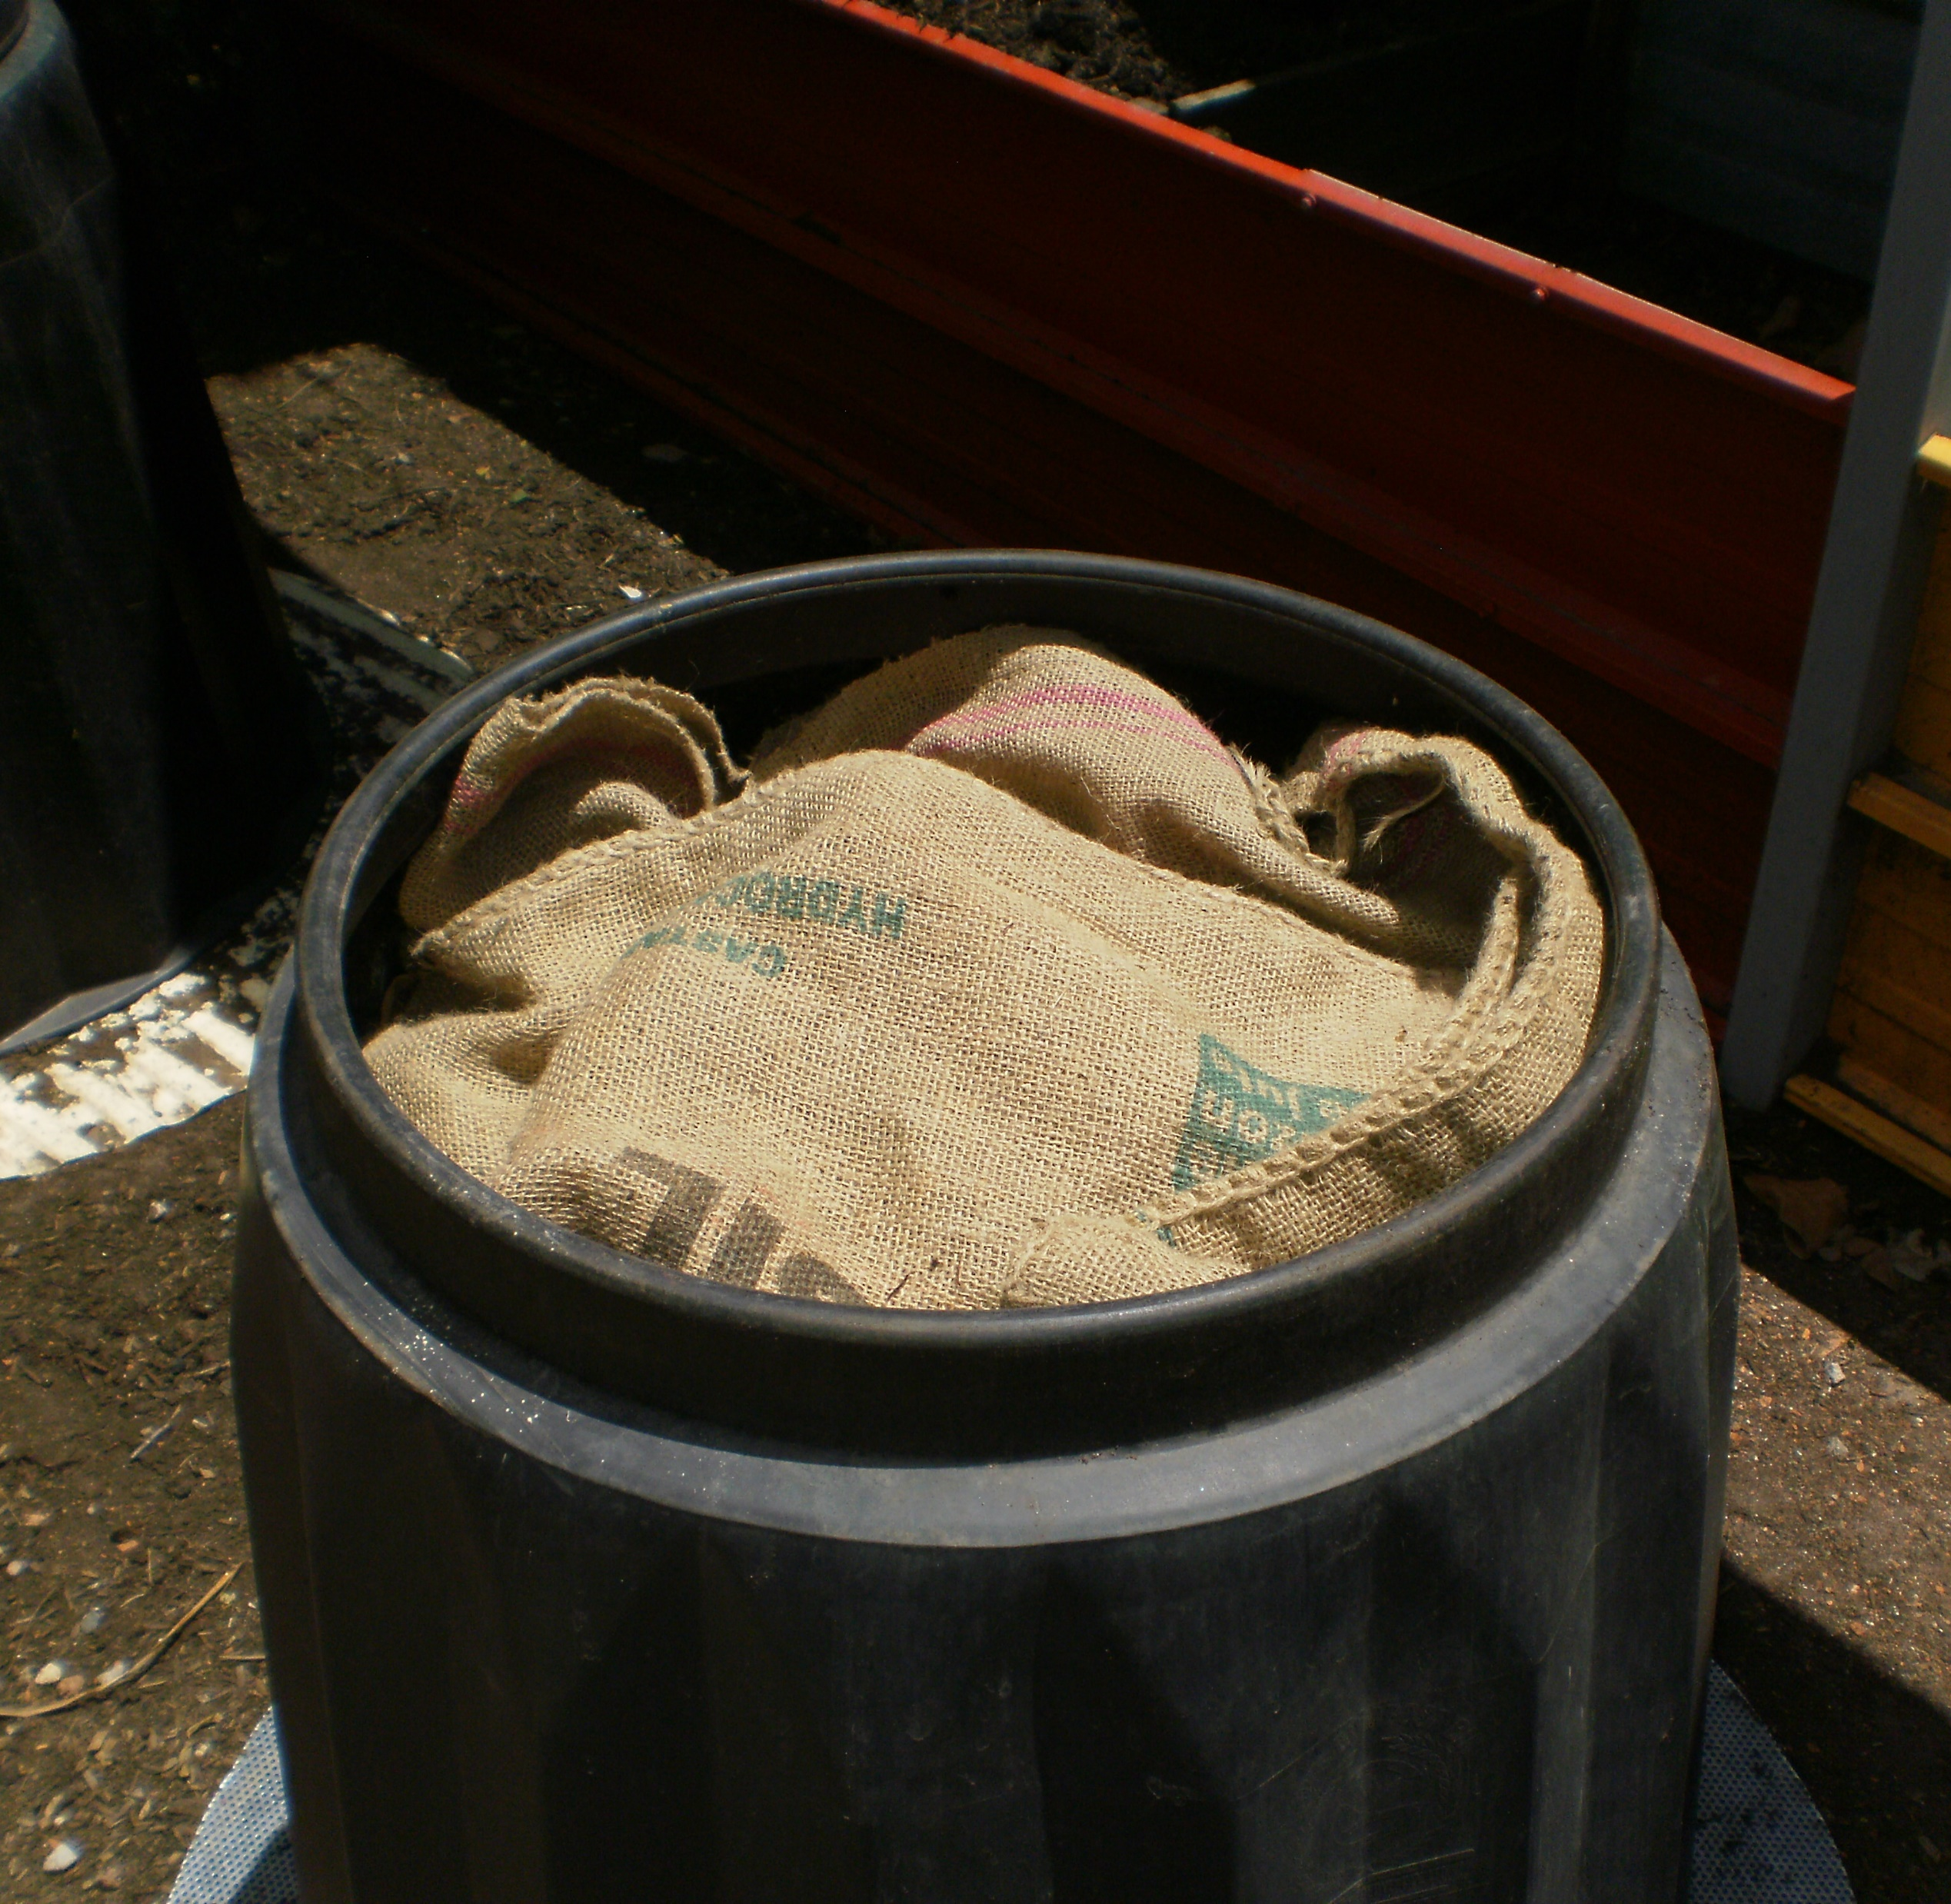
7. Put the bag covers back on
Add a second bag cover to each bin to retain moisture and reduce evaporation.

Slide 10
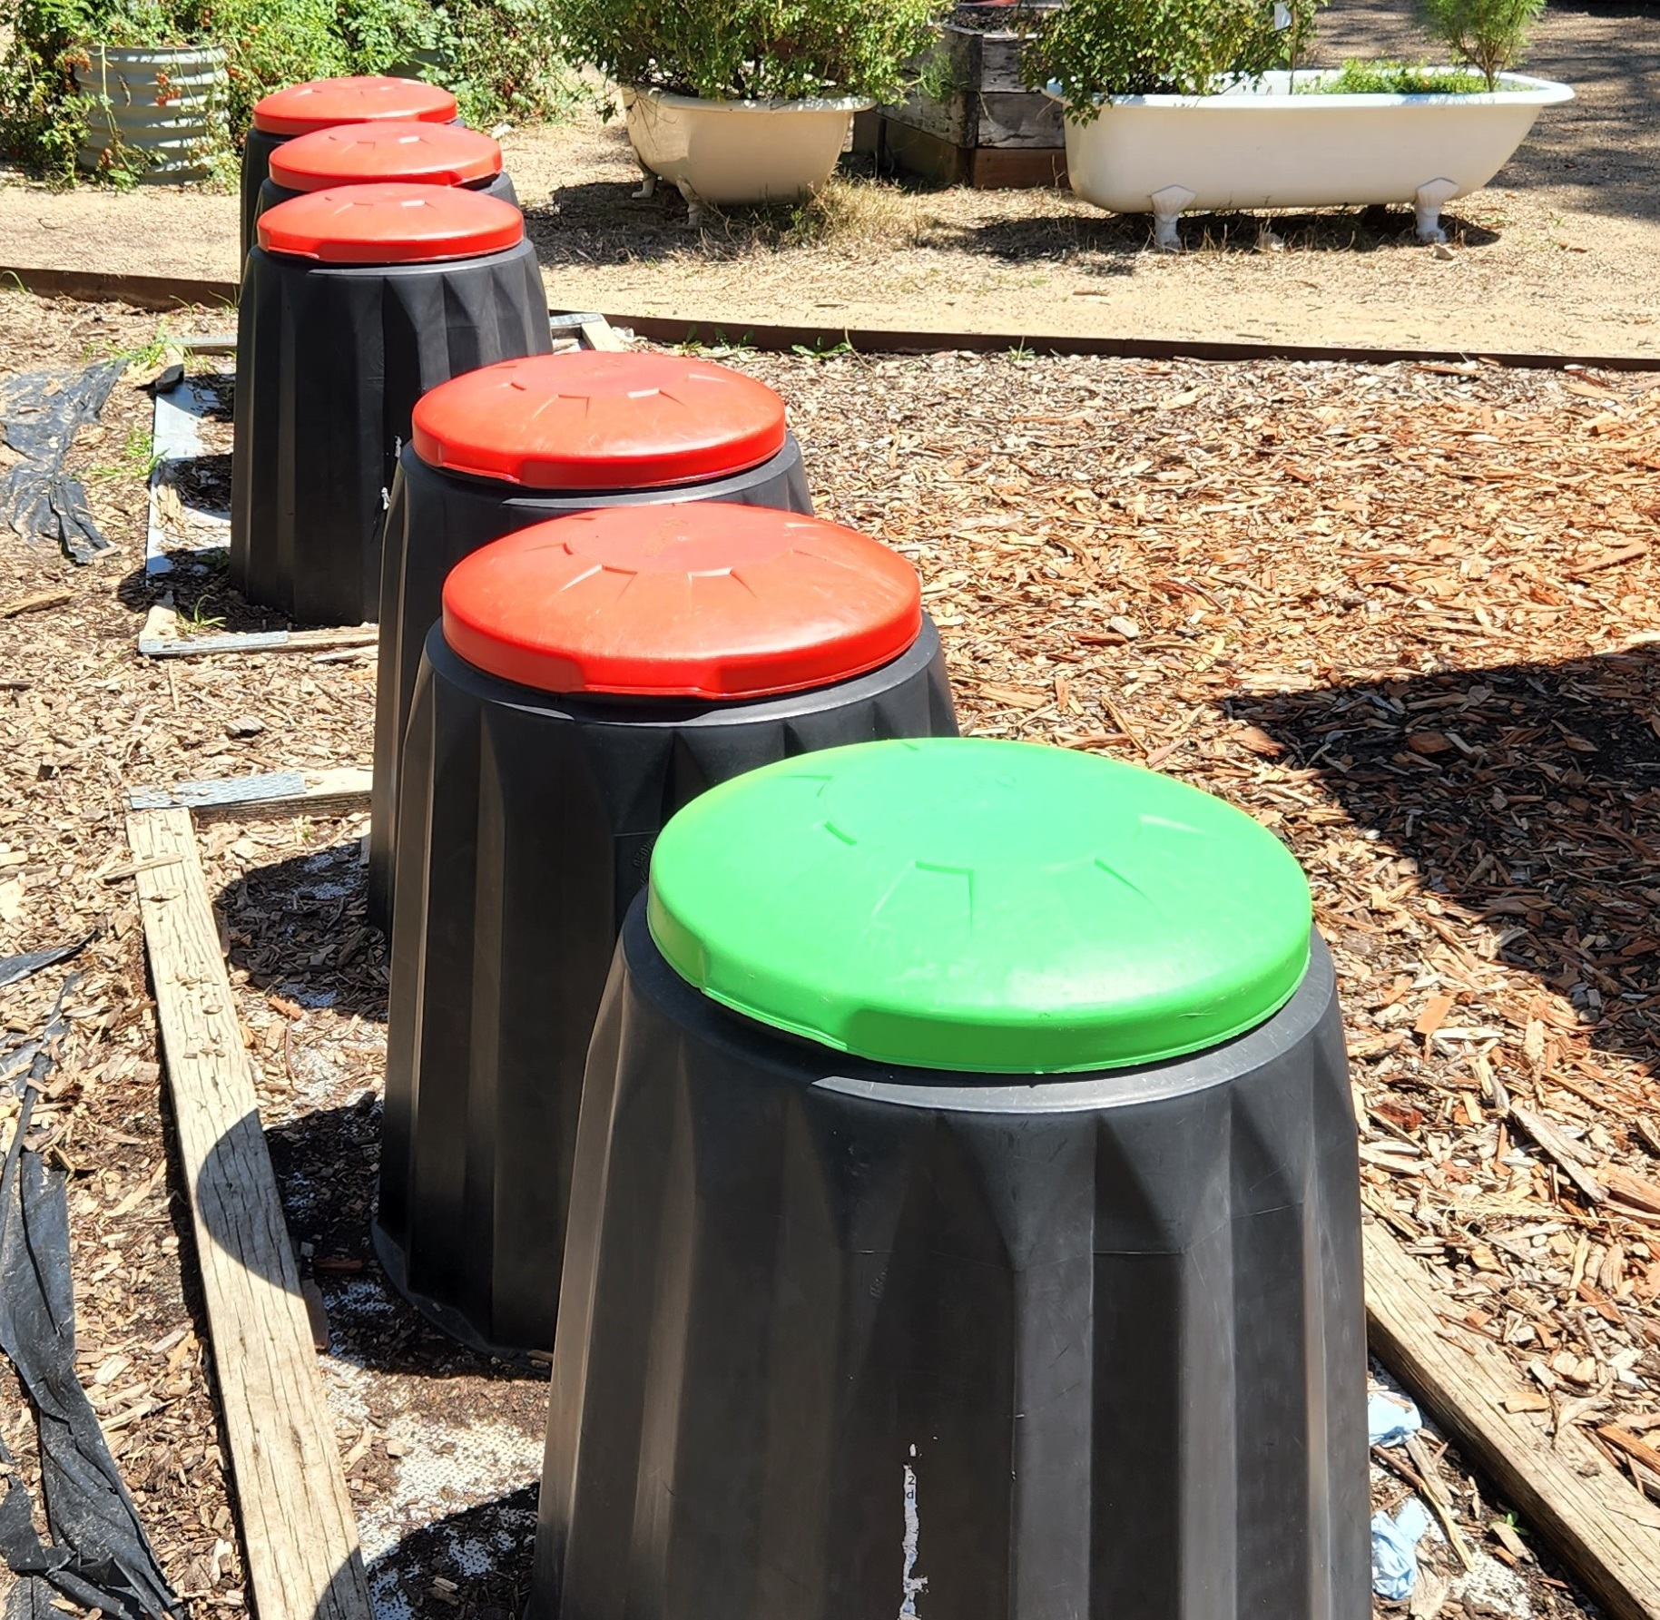
8. Put all lids back on

Slide 11

9. Say goodbye for the holidays

Slide 12
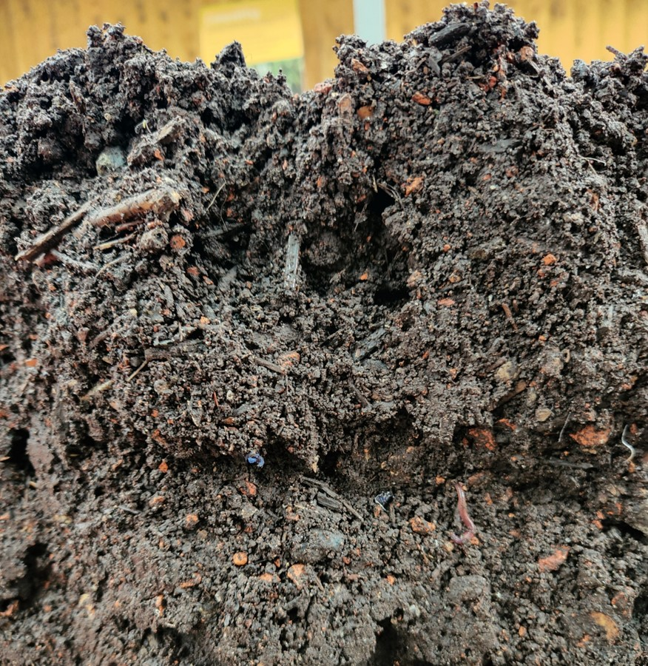
10. On your return, take of all the lids and blankets and give all the bins a good water and mix
You should have some superb compost for your gardens.

Slide 13


Acknowledgements

