Slide 1
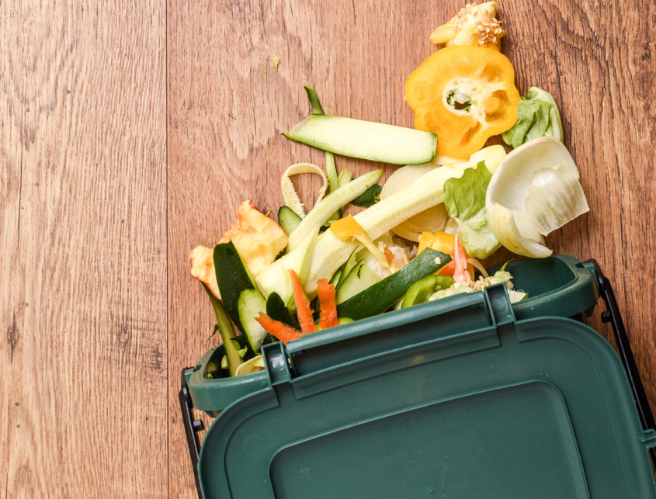
Solving Organic Waste in Schools
Cleaner Training
DD Month 2025

Slide 2
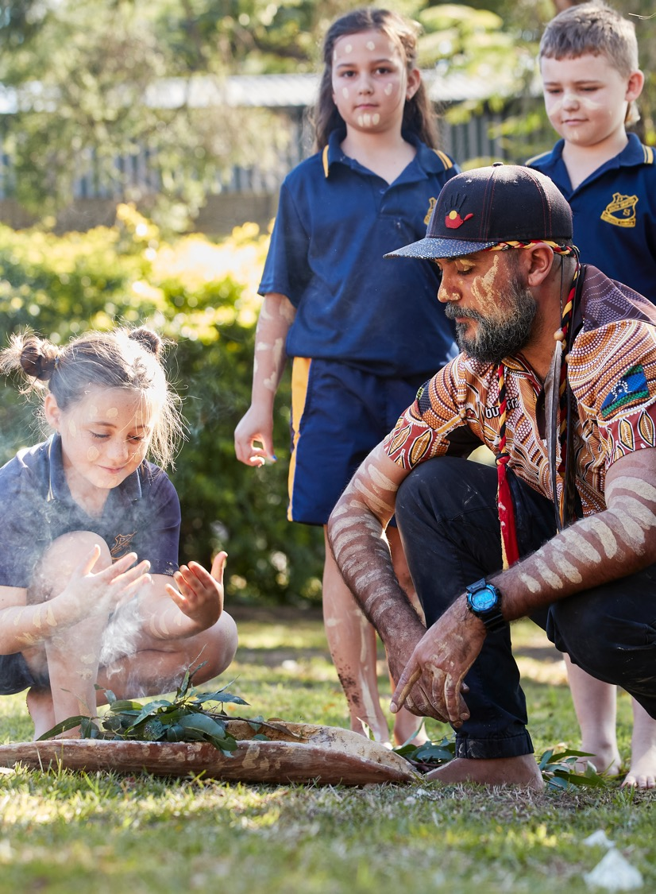
Acknowledgement of Country
We recognise the Ongoing Custodians of the lands and waterways where we work and live. We pay respect to Elders past and present as ongoing teachers of knowledge, songlines and stories.
We strive to ensure every Aboriginal and Torres Strait Islander learner in NSW achieves their potential through education.

Slide 3
The NSW Government aims to reduce food waste to landfill by 50% by 2030
We need your help!
School cleaners are an essential and valued part of making our schools more sustainable
It is the responsibility of all school staff and students to put their waste in the correct bins
Separating our waste to reduce what we throw 'away' to landfill will:
        Reduce greenhouse gases (especially from food waste in landfill)
        Save valuable resources
        Stop school's wasting money on landfill levies
School Cleaners will use consistent systems for bins, bin placement, bin lids and liner colours
Emptying to respective collection bins is critical
Thank you for your taking care in this area. Together we can make a big difference.

Slide 4
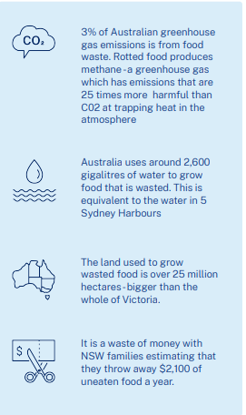


What is so bad about food waste?
3% of Australian greenhouse gas emissions is from food waste. Rotted food produces methane - a greenhouse gas which has emissions that are 25 times more powerful than CO2 at trapping heat in the atmosphere.
Australia uses around 2,600 gigalitres of water to grow food that is wasted. This is equivalent to the water in 5 Sydney Harbours.
The land used to grow wasted food is over 25 million hectares – bigger than the entire state of Victoria.
Wasting food wastes money. It is estimated that each family in NSW throws away $2,100 of uneaten food a year.
https://www.youtube.com/watch?v=wgLuXvtaLyQ
Notes:
https://www.youtube.com/watch?v=wgLuXvtaLyQ
Stop at 0.54sec
KEY POINTS: Food waste is feeding climate change and wasting resources

Slide 5
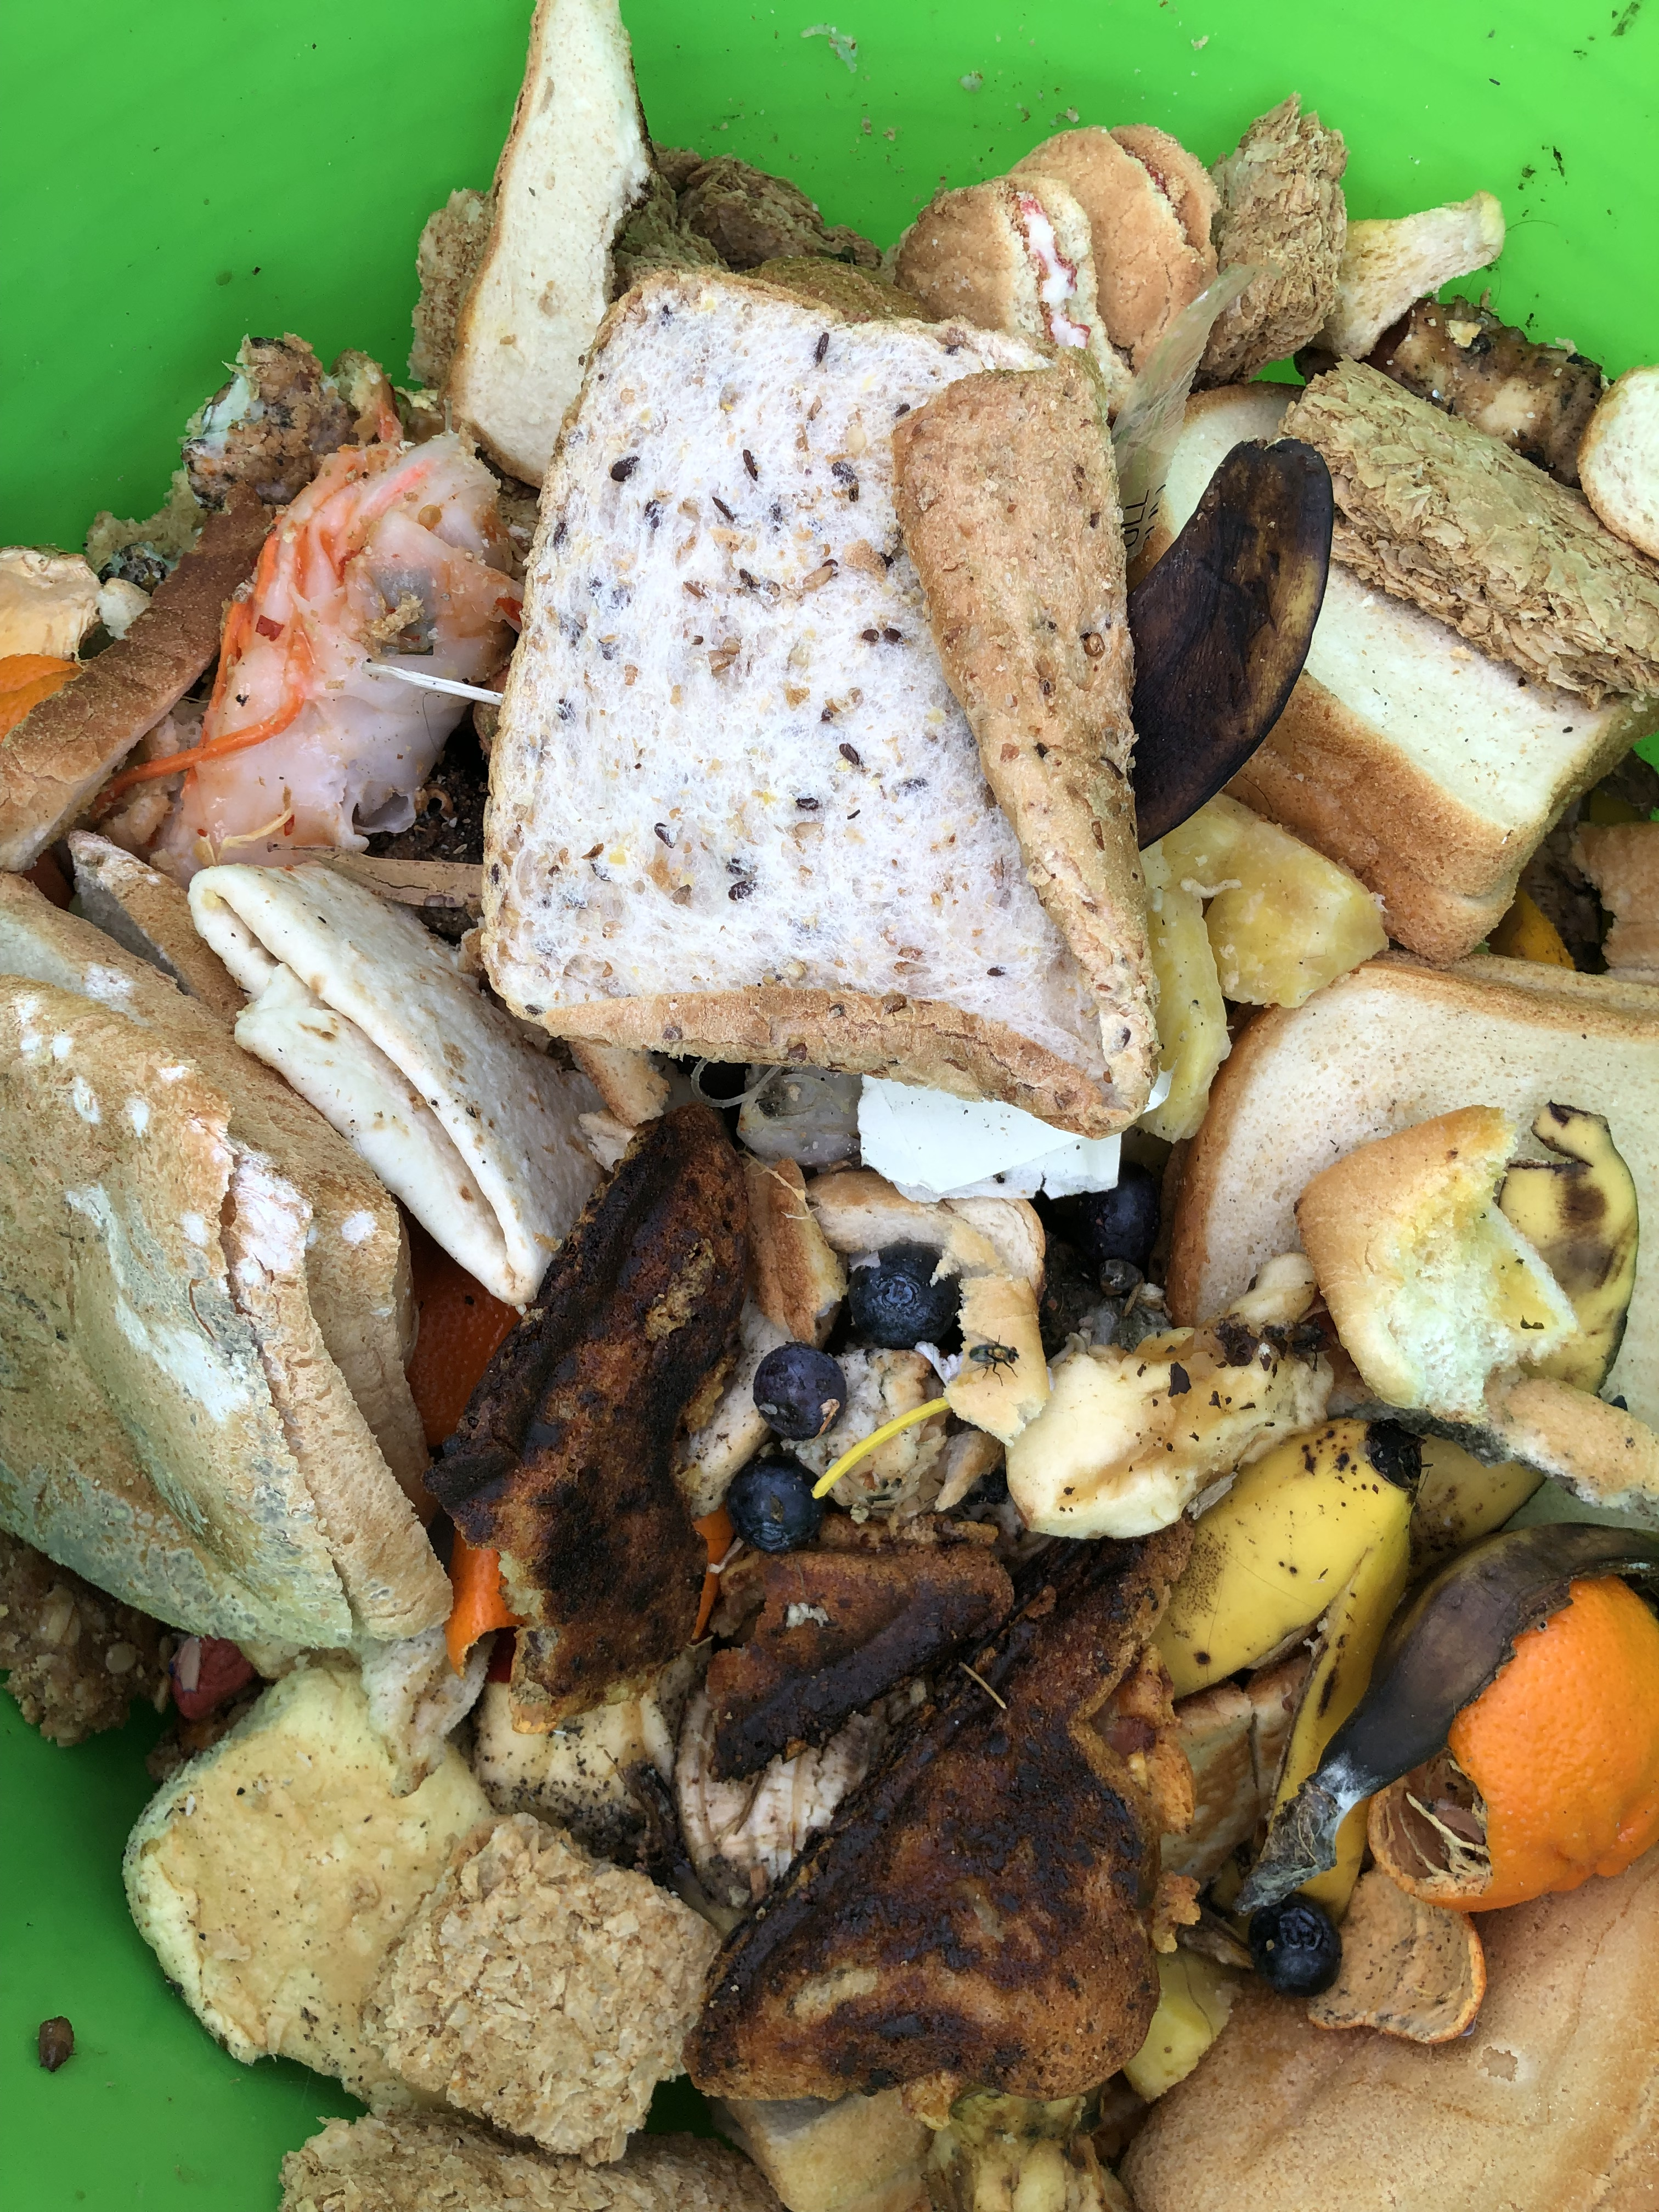
How much food waste do we generate at schools?
Average food waste across NSW per student is 7kg a year
An average Central Coast school wastes 23kg of organic waste in one day (some schools waste much more!)
= 4.6 tonnes of food waste per school per year being sent to landfill
= 9.66 tonnes of CO2 equivalent greenhouse gases going into our atmosphere per school per year
Composting this food waste would avoid 6.9T of greenhouse gases (releasing only a natural 2.76T of CO2 equivalent greenhouse gases)

Slide 6
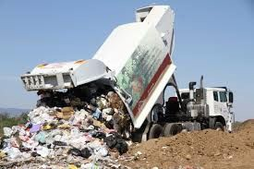
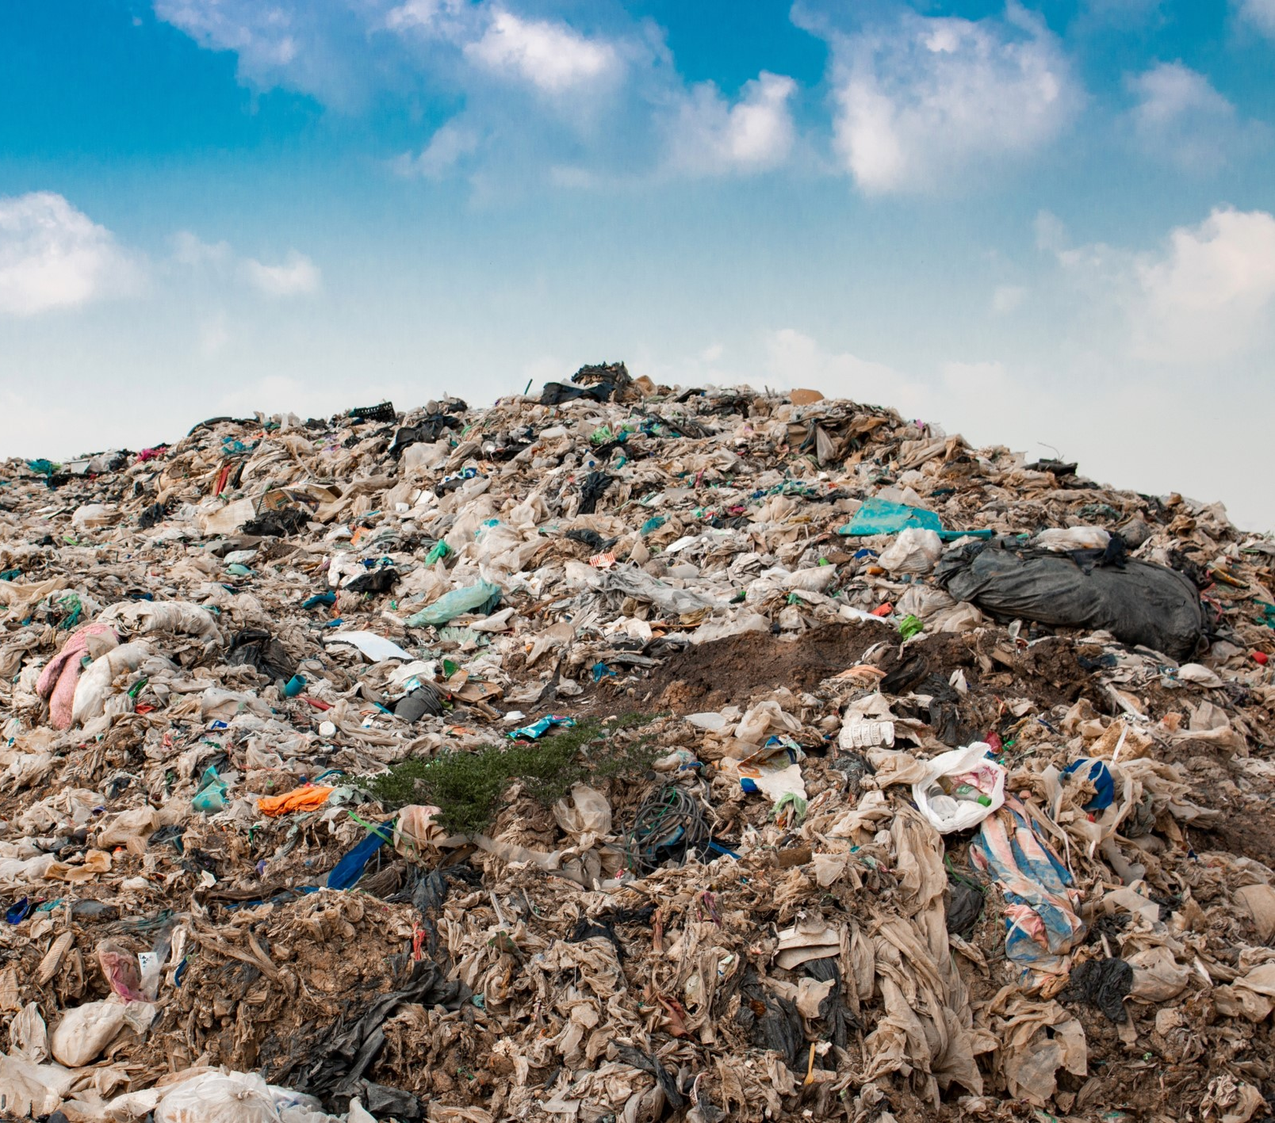
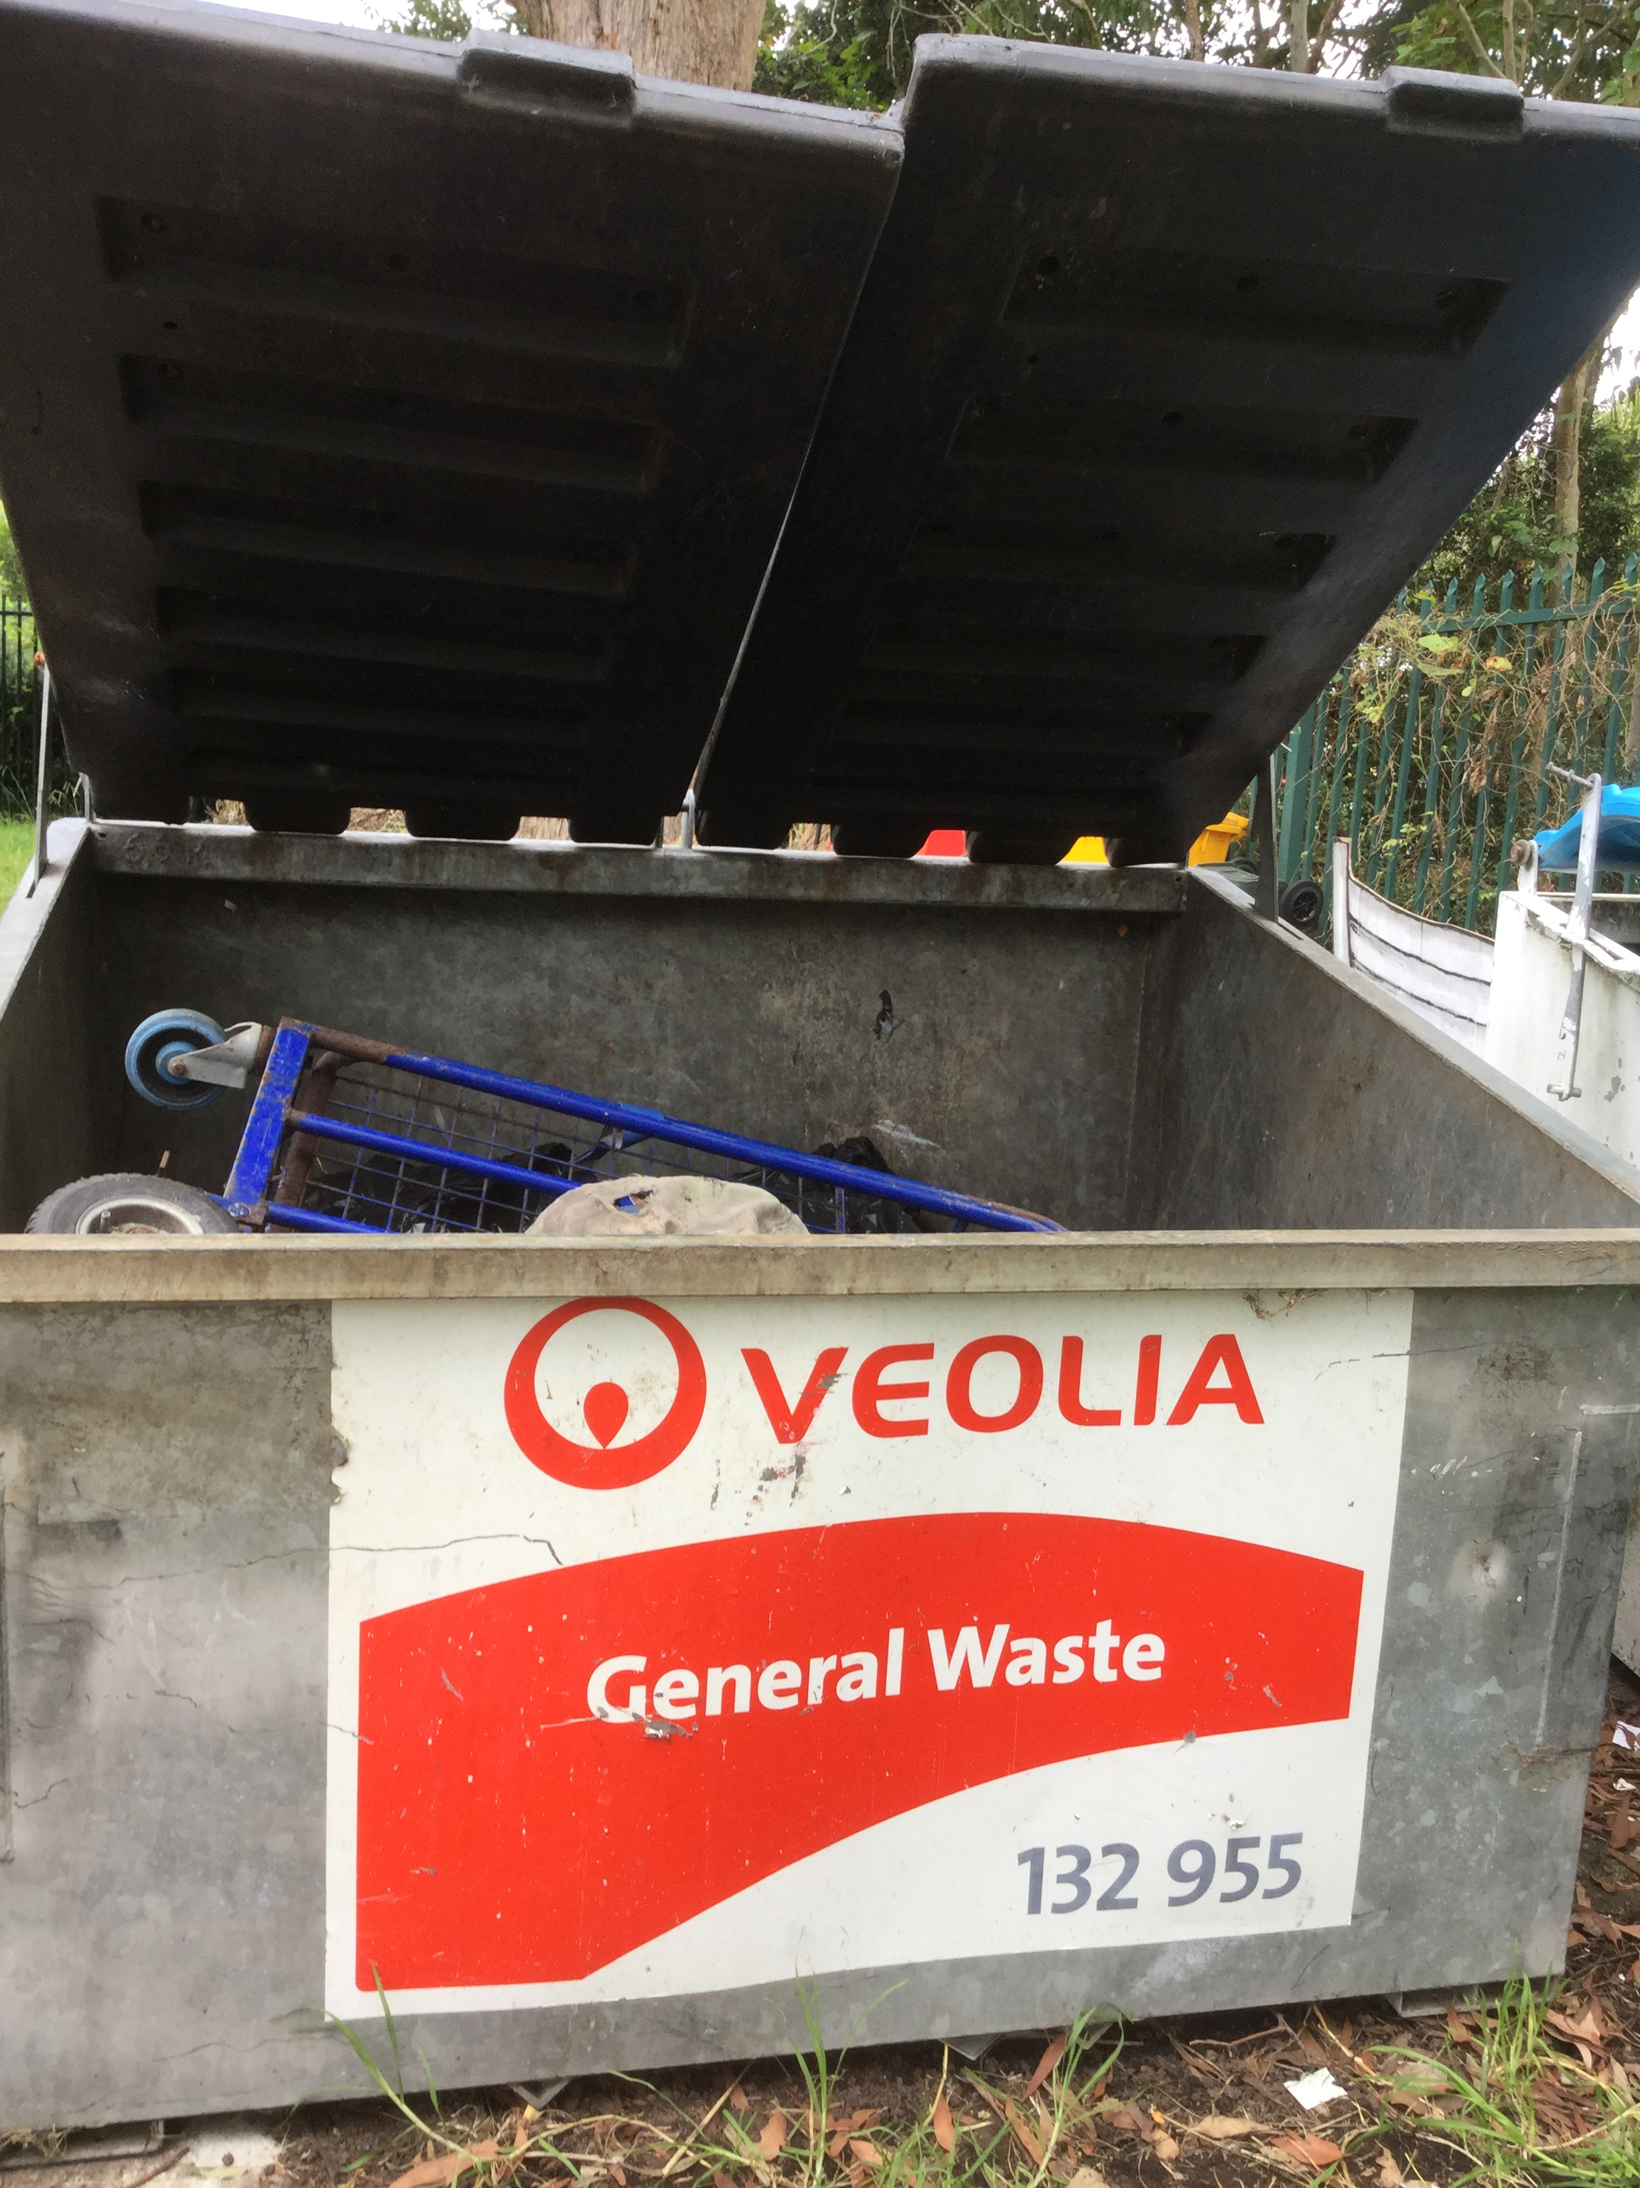
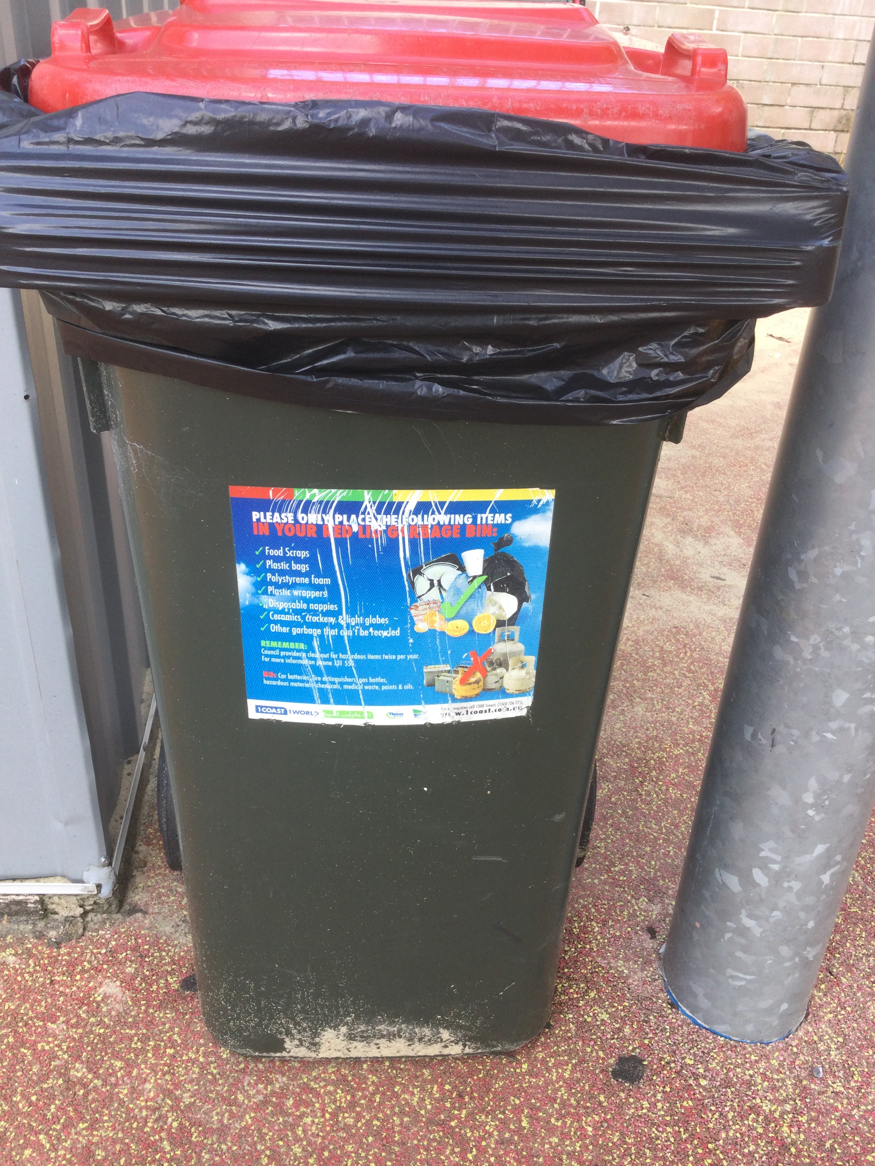
What happens to most food waste at the moment?
It goes into our red general waste which goes into landfill.
Organic waste buried in landfill creates methane gas and other greenhouse gases that are heating up our planet.

Slide 7
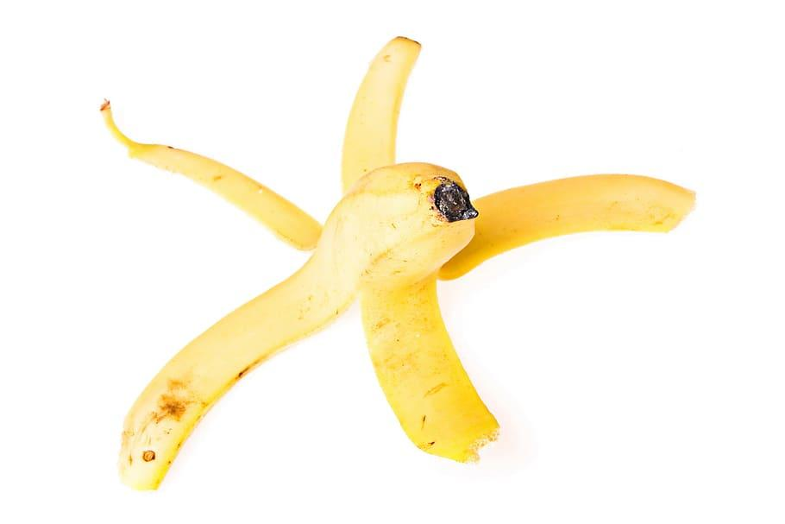
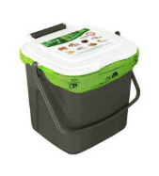
Why solve organic waste?
Garden and food waste does not need to go to landfill
When it does go to landfill it wastes resources and money and releases powerful greenhouse gases that are contributing to climate change
The most sustainable thing to do with food and garden waste is to compost it.
Now you just need to put me in the food scrap bucket please
My life is complete
Notes:
Insert picture – if your food scraps could talk

Slide 8
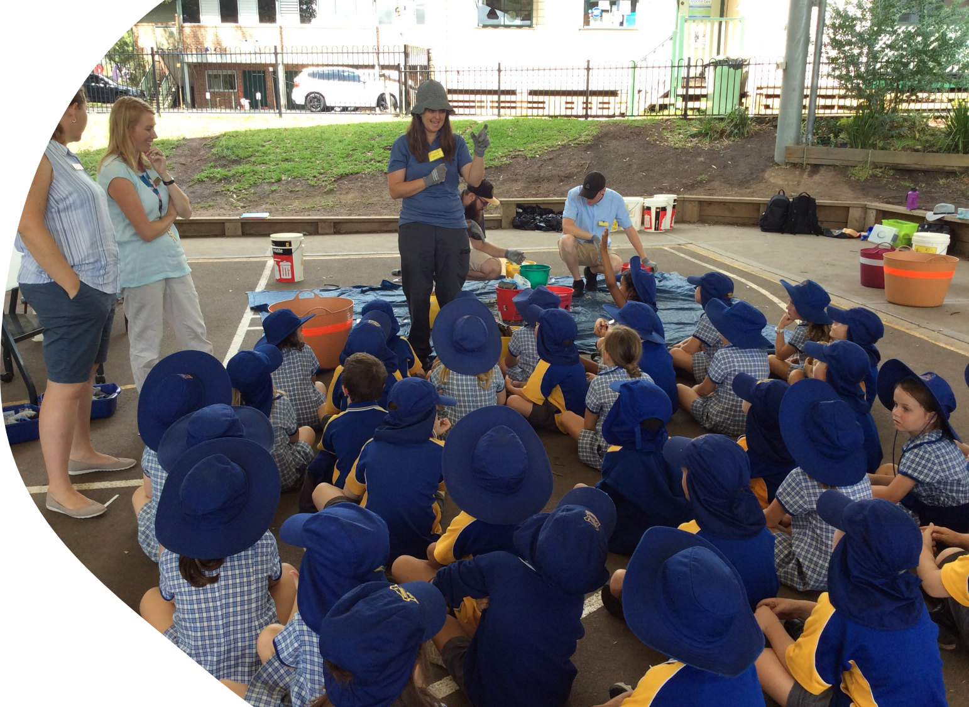
Solving Organic Waste Program Overview
We are one of ten schools participating in the program
Sponsored by NSW Environment Protection Authority (EPA)
Supported by NSW Department of Education
We will measure our school food waste, implement new collection systems and make sure the right things go in the right bins.
XX Public School

Slide 9
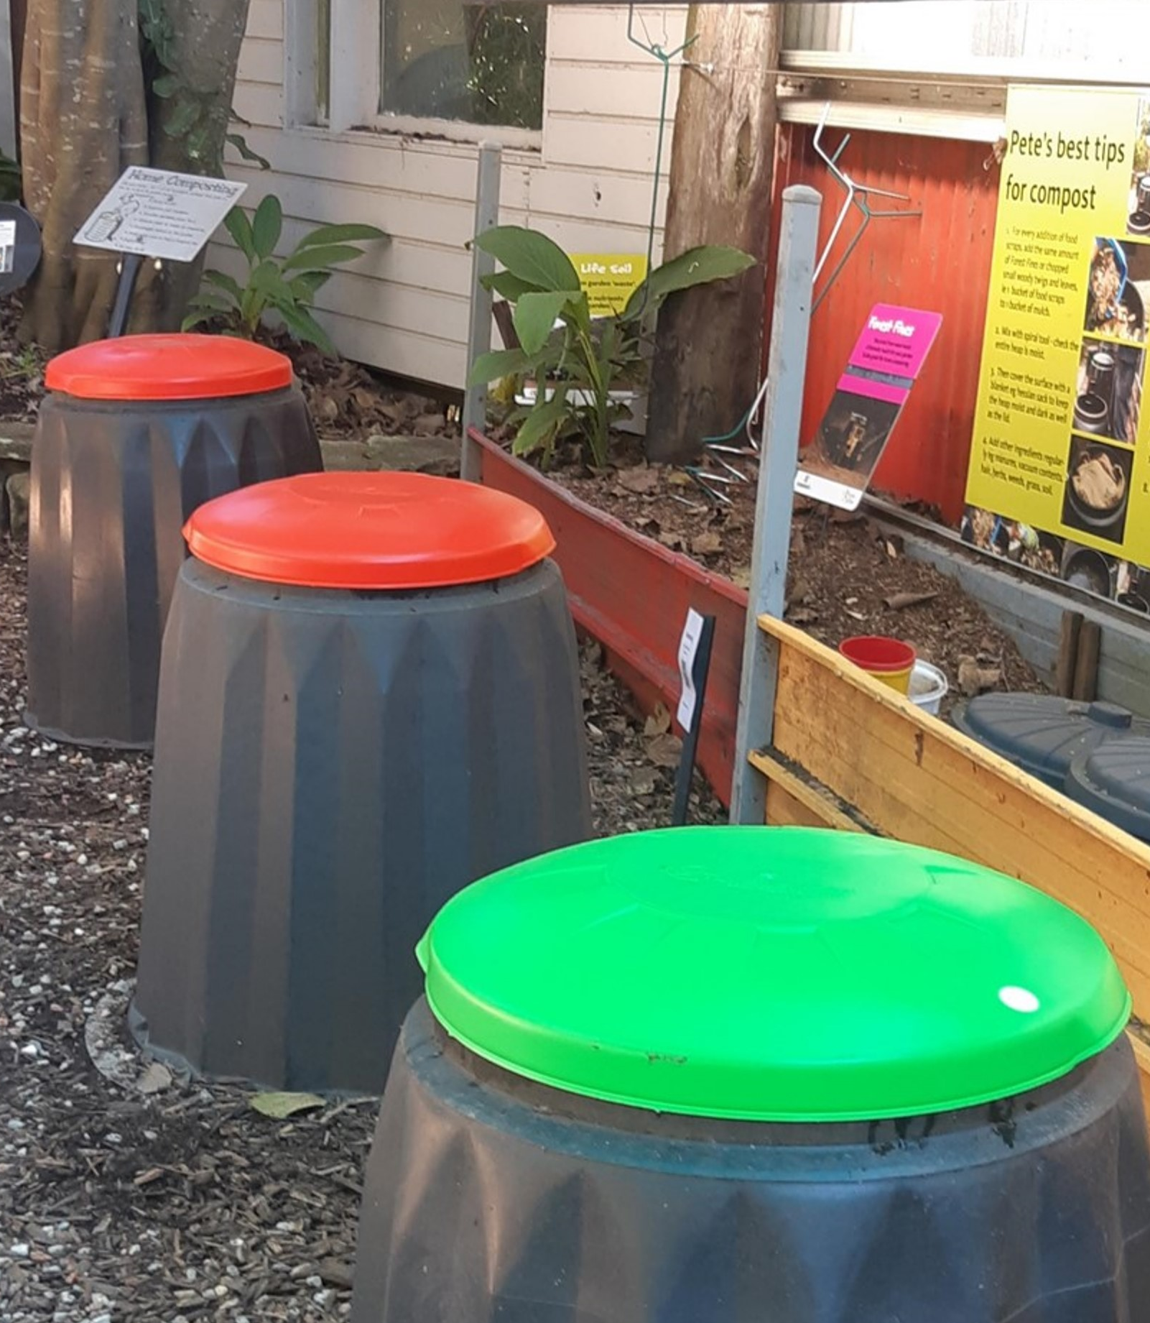
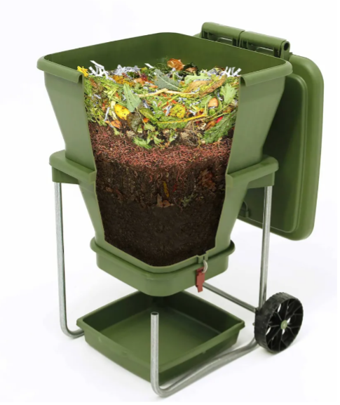

Program focus
Separating, collecting and managing food waste
https://www.epa.nsw.gov.au/your-environment/recycling-and-reuse/business-government-recycling/food-organics-and-garden-organics/scrap-together

Slide 10
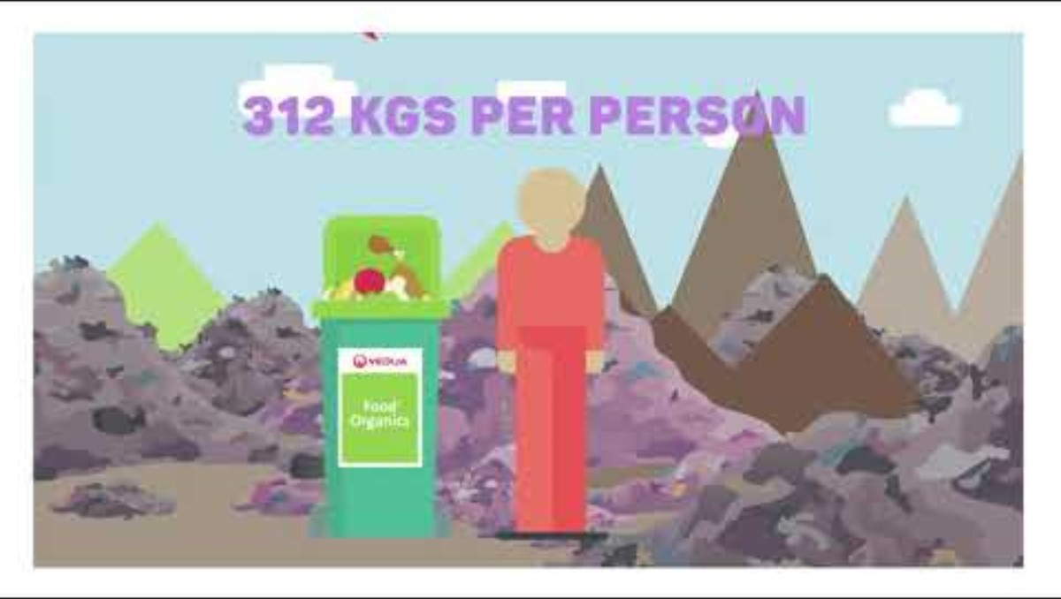
Program focus - continued
A commercial food waste service will take what we can’t manage on site
Organics Resource Recovery facilities make mountains of soil and mulches from our organic waste.
https://www.youtube.com/watch?v=HNJ11DMMvs8
Notes:
Most households across NSW will have Food Organics & Garden Organics collections by 2030.
Insert Veolia video with green or burgundy bin!
I chose green bin
Burgundy bin is https://www.youtube.com/watch?v=IIw96Jihp5M

Slide 11
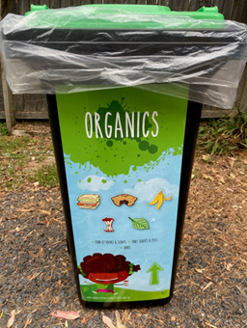
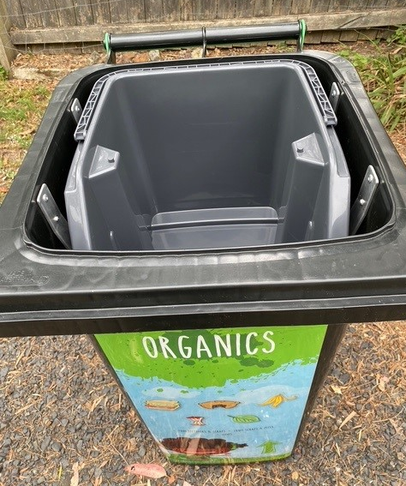
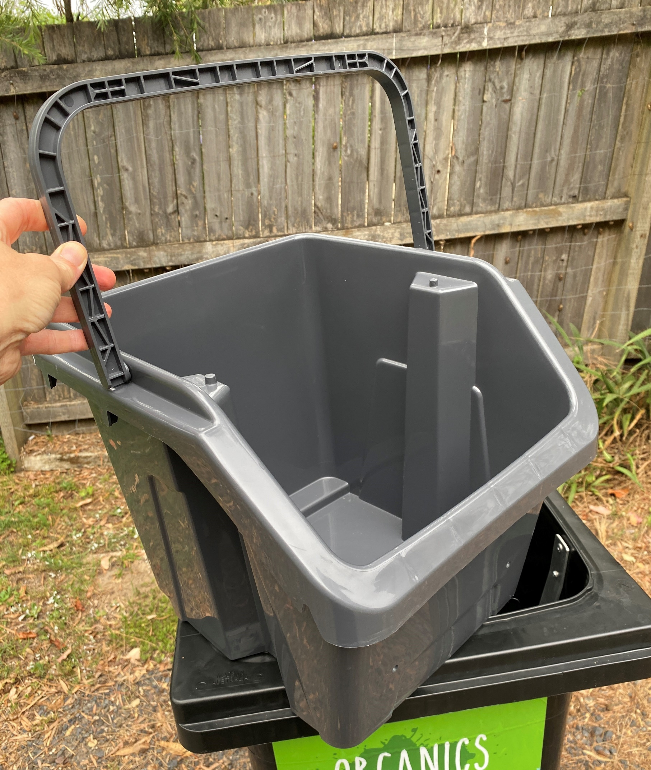
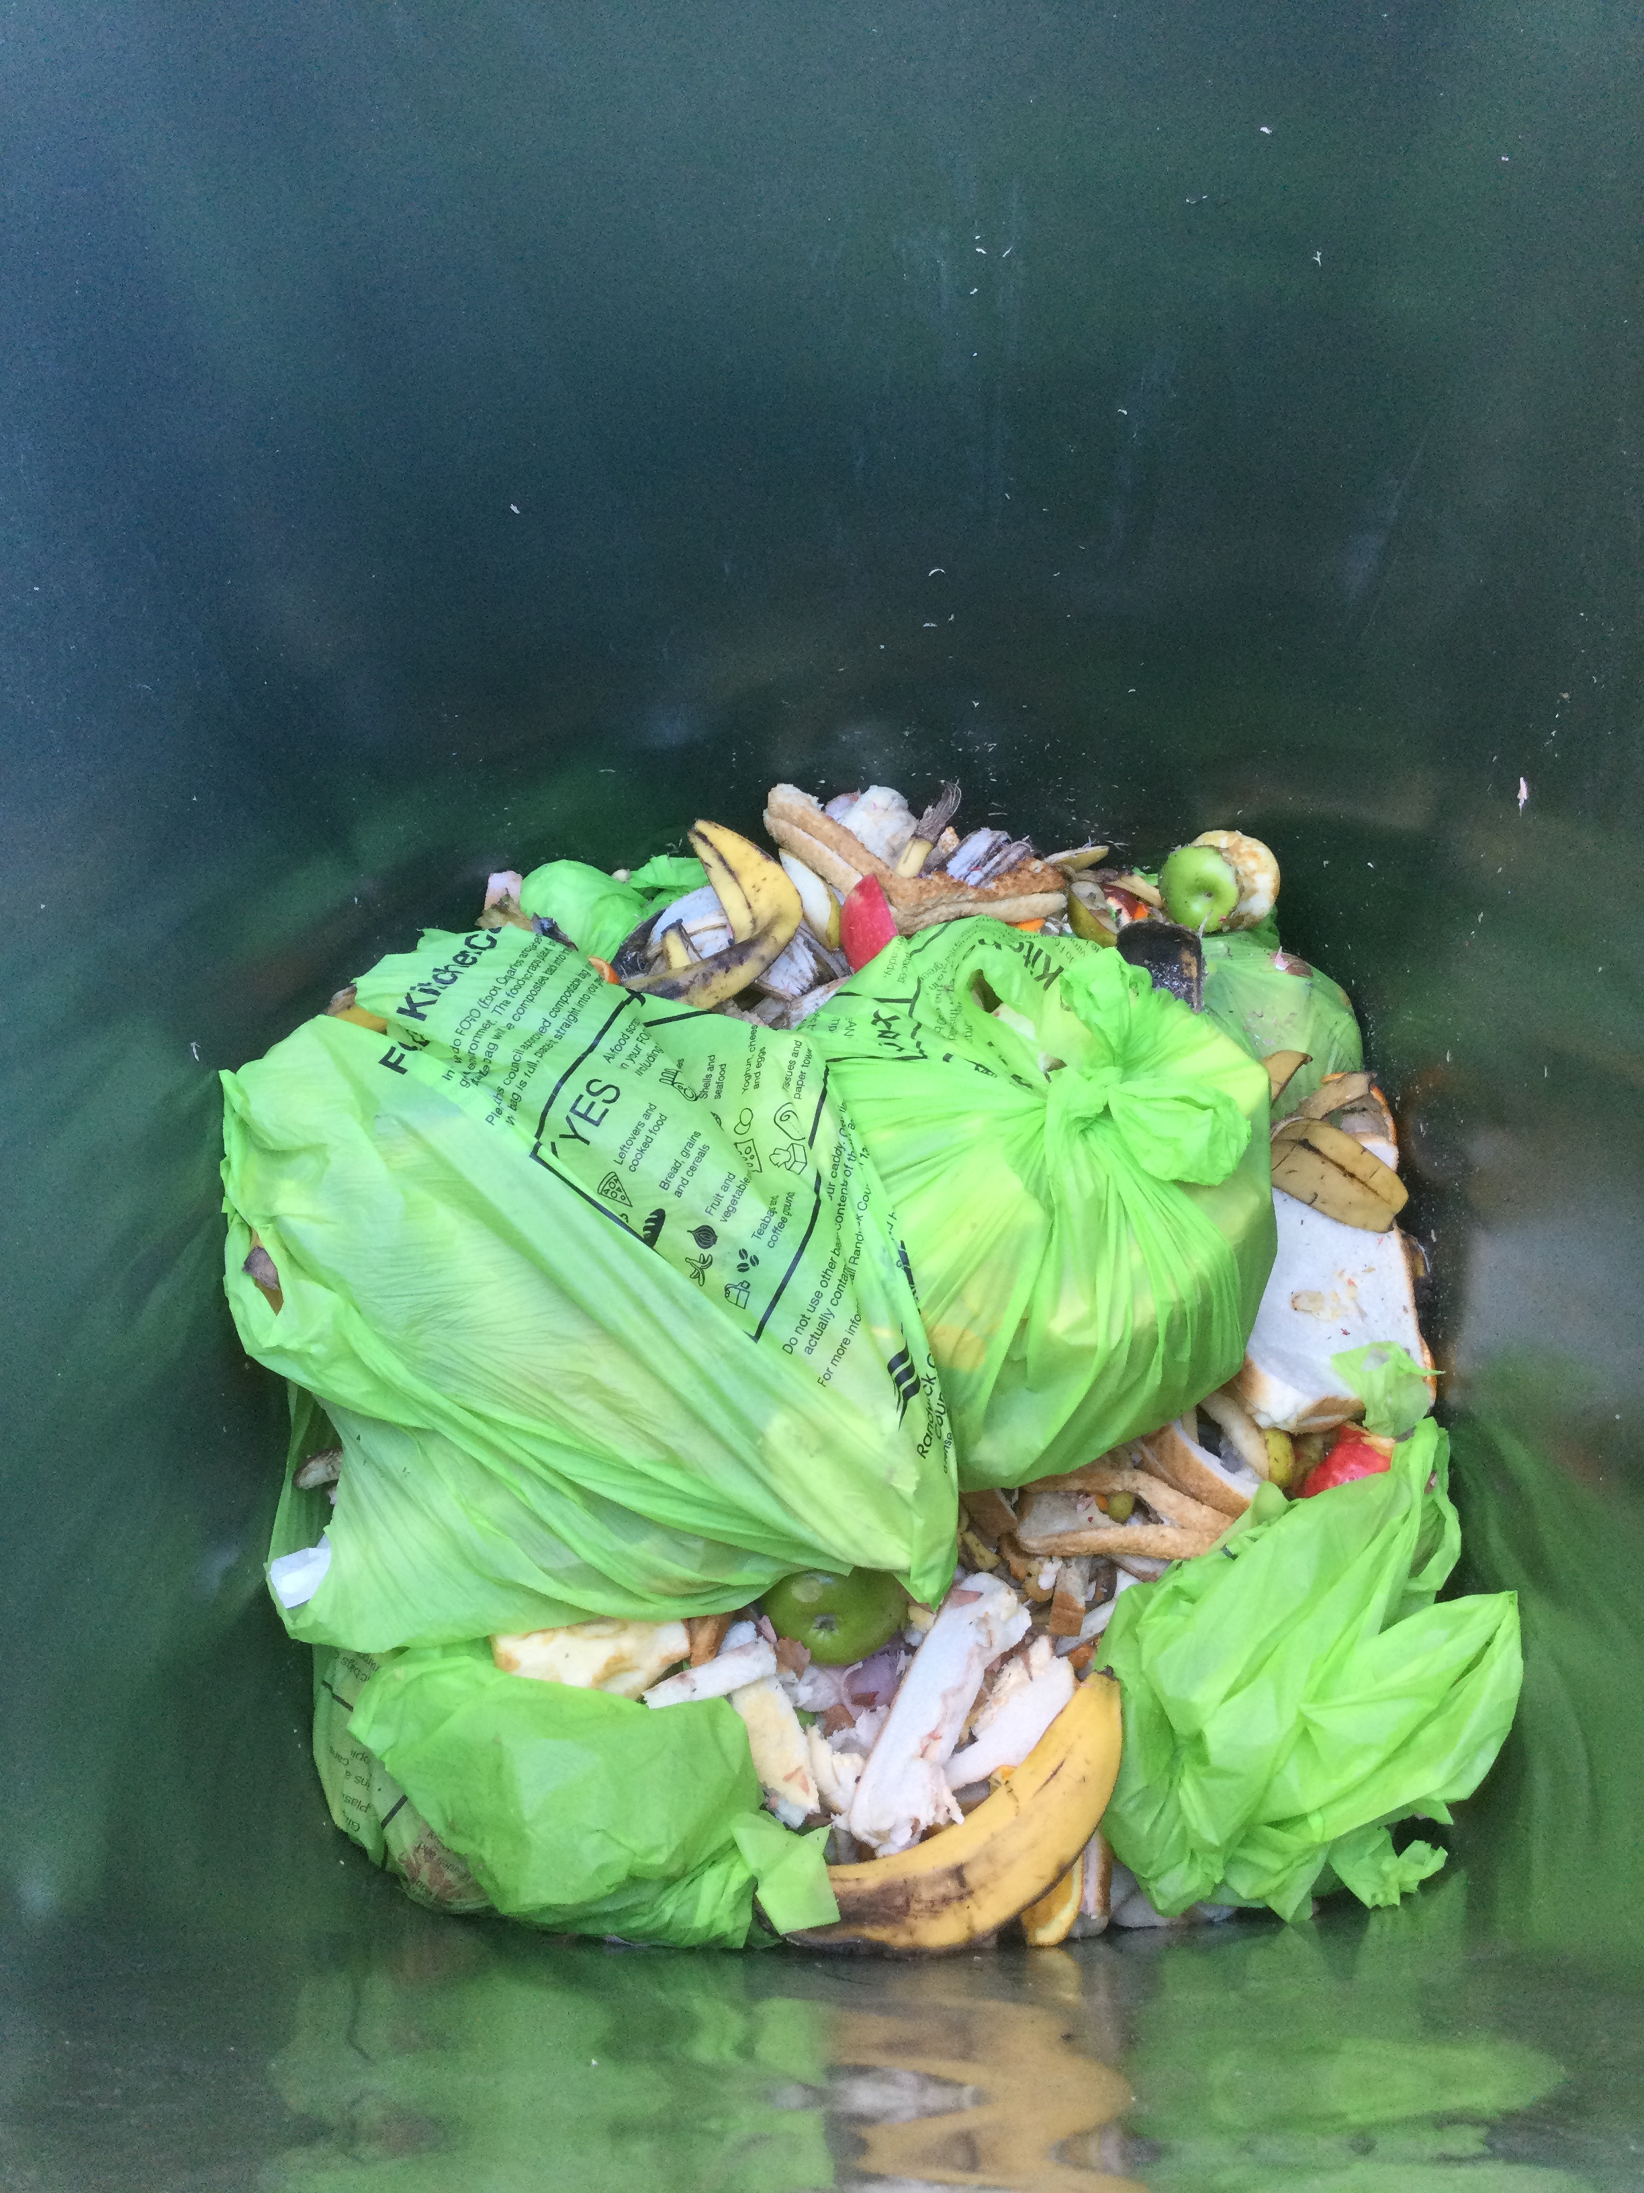
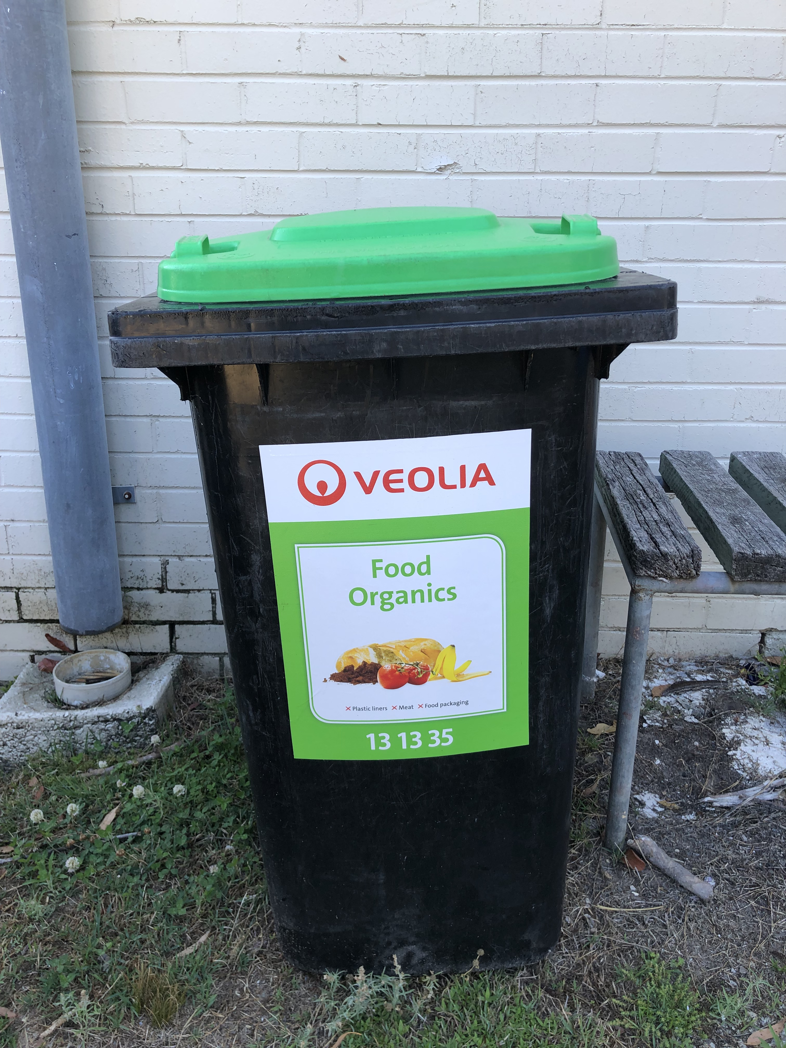
The school will start using new bins
A whole of school approach is vital for ongoing success.
7L Organic caddies
Students will wash food scrap caddies each time they empty them.
We need you to help by emptying the playground bins into the Veolia bins
The wheelie bin insert can be lined with a 120L clear bin liner. This means you can help our waste champions by letting them know if you see anything that isn’t food waste in that bag.
Remember to only put food waste into the Veolia bin and either reuse the plastic bag or put it into landfill.
Playground bin and insert
Commercial collection bin

Slide 12
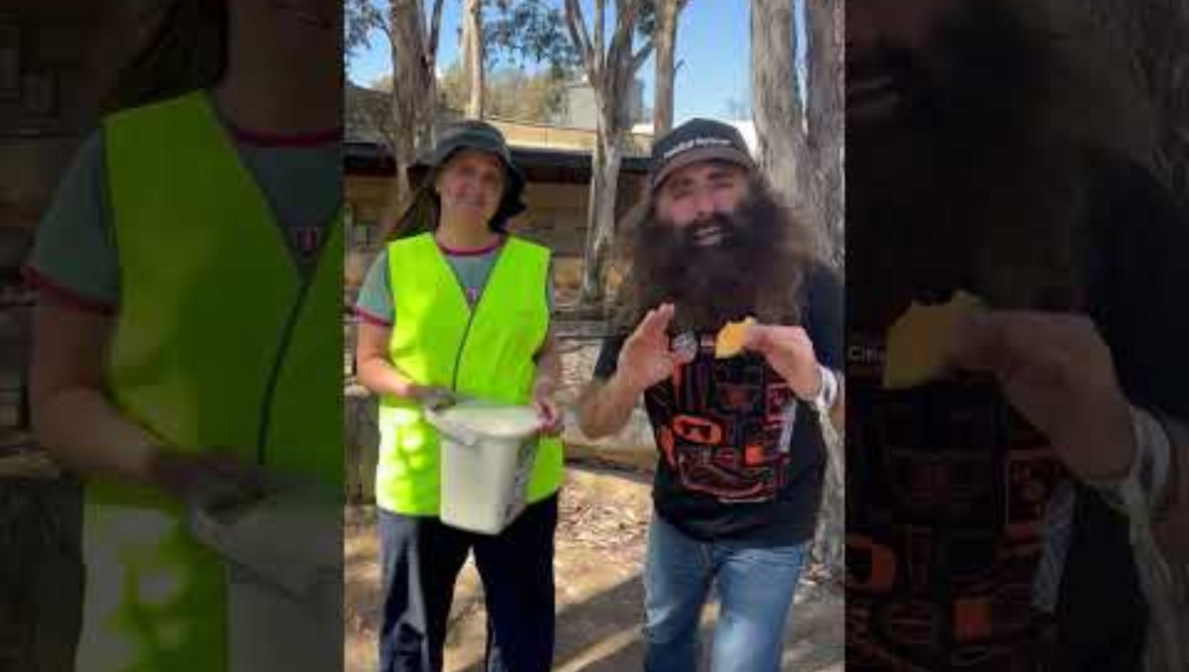
Let’s make a difference every day!
Your school is one of 10 Central Coast Schools taking part in the Solving Organic Waste program in 2025.
What we test and learn here will inform a roll out to the rest of NSW.
Thanks for being part of it!
https://www.youtube.com/watch?v=KllwUcHoGUo

Slide 13
Questions?
Solving Organic Waste – Cleaner Training

Slide 14

Acknowledgements
The Solving Organic Waste project is a partnership between the NSW Environment Protection Authority and NSW Department of Education.

